Slide 1
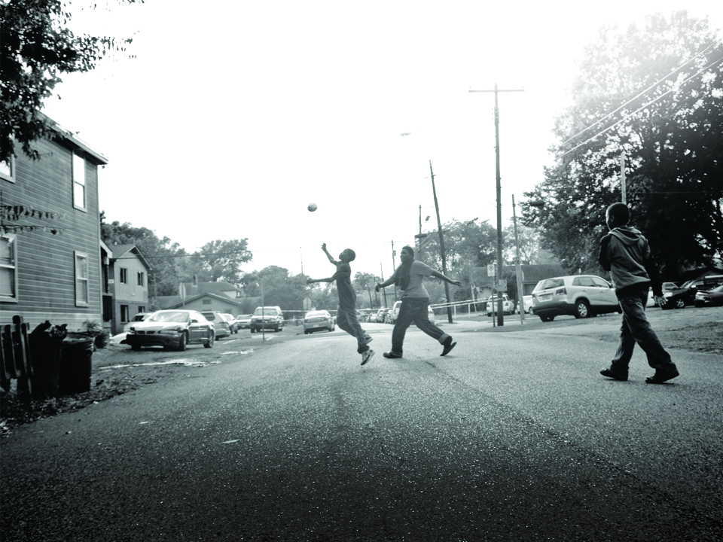
Community Safety for Healthy Community Change
Healthy Neighborhood Learning Collaborative Meeting
November 18, 2016
Jason Cooper, LISC Safety
Miguel Melendez, Ibero-American Development Corporation

Slide 2


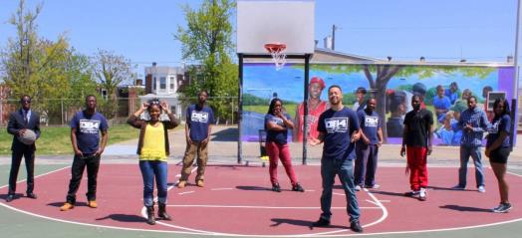
Healthy Neighborhoods Collaborative
Community Safety as an Integral Component of Healthy Community Change

Slide 3




Slide 4
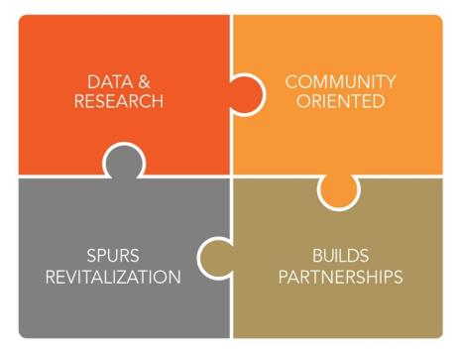
Overview – The BCJI Approach
Across the country, in neighborhoods with persistent crime problems, BCJI sites convene diverse partners including local law enforcement, researchers, and residents to analyze crime drivers and pursue strategies that improve safety and create opportunities for community-police collaborations.
Notes:
Across the country, in neighborhoods with persistent crime problems, BCJI sites convene diverse partners including local law enforcement, researchers, and residents to analyze crime drivers and pursue strategies that improve safety and build community-police collaboration.

Slide 5
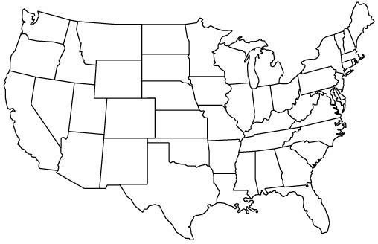
Where is BCJI Happening
FY 2012 SITES
Austin, TX
Baltimore, MD
Brooklyn, NY
Buffalo, NY
Charleston, WV
Dayton, OH
Detroit, MI
Lowell, MA
Milwaukee, WI
Omaha, NE
Philadelphia, PA
Portland, OR
San Antonio, TX
San Bernardino, CA
Seattle, WA
FY 2014 SITES
Alameda County, CA
Battle Creek, MI
Coahoma County, MS
Denver, CO
Durham, NC
Flint, MI
Highland County, OH
Huntington, WV
Miami-Dade County, FL
Minneapolis, MN
New Haven, CT
Newark, NJ
Phillipsburg, NJ
Rockdale County, GA
Towaoc, CO
Tulsa, OK
Worcester, MA
FY 2013 SITES
Albany, GA
Baton Rouge, LA
Cleveland, OH
Corning, CA
Erie, PA
Evansville, IN
Kansas City, MO
Los Angeles, CA
Nashville, TN
Providence, RI
San Francisco, CA
Springfield, MA
Tampa, FL
Syracuse, NY
FY 2015 SITES
Atlanta, GA
Berea, KY
Brooklyn, NY
Harrisburg, PA
Hayward, CA
Indianapolis, IN
Langley Park, MD
Madison, WI
Meridian, MS
Minneapolis, MN
Norwalk, CT
St. Louis, MO
Youngstown, OH
Washington, DC
Cross-sector teams are using evidence-based, community-driven strategies
to address crime hot spots in specific neighborhoods in each city.
Learn more about Byrne Criminal Justice Innovation (BCJI): www.lisc.org/BCJI
Notes:
Since 2012, the BCJI program has grown to encompass a diverse network of 65 sites in urban, rural, and tribal areas all over the country.

Slide 6
Common Crime Issues Across BCJI Sites
Notes:
In troubled neighborhoods, public safety and public health are inextricably linked. Research shows that crime and the fear of crime exert powerful effects on health, particularly mental health, nutrition and physical activity.
Parents who fear for their children’s safety do not let them play sports in parks or bicycle to school.
Grocery chains are reluctant to invest in high crime communities, thereby reducing healthy food options.
The stress of living in a high crime, high violence environment has been shown to negatively impact physical and mental health in the short- and long-term.
While community developers, law enforcement and public health agencies have increasingly recognized a shared interest in poverty, violence and other societal problems, there is still a need to identify and support best-practice models for reducing crime and the fear of crime as a barrier to health, particularly in lower-income and minority communities that experience disproportionately high rates of obesity, diabetes and other ills.

Slide 7
Building Partnerships
BCJI projects are coordinated by law enforcement agencies, public housing authorities, mayor’s offices, and a variety of non-profit organizations.

Slide 8
Common Strategies Used by BCJI Sites

Slide 9
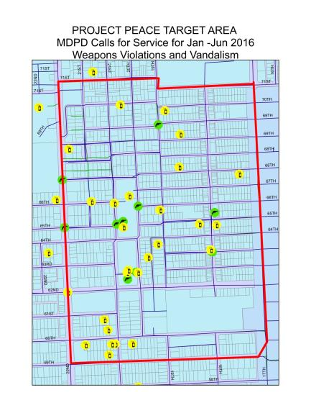
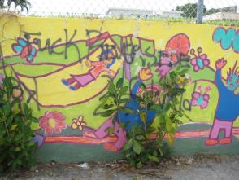
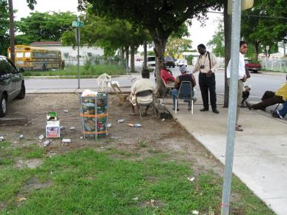

Slide 10
Crime Prevention, Crime Control, and Collective Efficacy
Formal social control is the responsibility of the police (state laws allow and mandate this)
Informal social control is practiced by citizens all the time – we do this with our families and within our neighborhoods
Research has shown that in areas of high collective efficacy crime is low.
Research also shows that in micro-areas and small pockets of ‘bad’ neighborhoods, where collective efficacy and social cohesion are high, crime is low.
Notes:
Collective efficacy is rooted in the notion that citizens who are willing to intervene, who have strong ties to their neighborhoods, and who trust each other are more likely to live in safer communities.

Slide 11
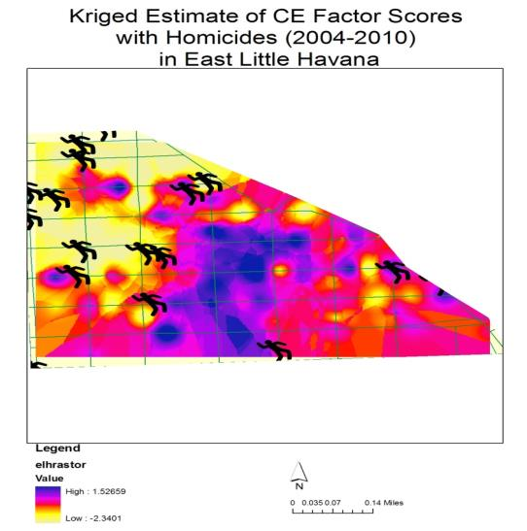
Collective Efficacy and Crime

Slide 12


Slide 13
5 Ways to Improve Crime Prevention
Problem Solving
Micro-targeting
Organizing the Community and Encouraging Volunteerism
Restoring Anchor Points
Investing in Research and Evaluation

Slide 14


For more information and updates on the
Byrne Criminal Justice Innovation Program,
please visit
www.lisc.org/bcji

Slide 15

Healthy Outcomes through Participation Education and Empowerment

Slide 16
A place-based story of grass-roots change
Located in NE Rochester, NY
Relatively small neighborhood
(20 blocks or so)
Neighborhood Boundaries:
South – Upper Falls Boulevard
East – North Clinton Avenue
North – Avenue A
West – Genesee River

Slide 17
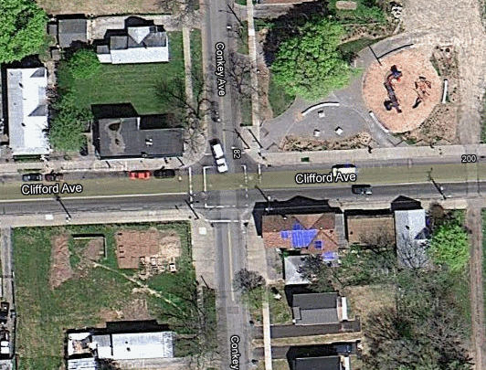
In the heart of our neighborhood...
There was a place for drug sales
Notes:
Talk about taking back public space, a park built, playground built, mural and garden developed, new trail this year, etc.

Slide 18
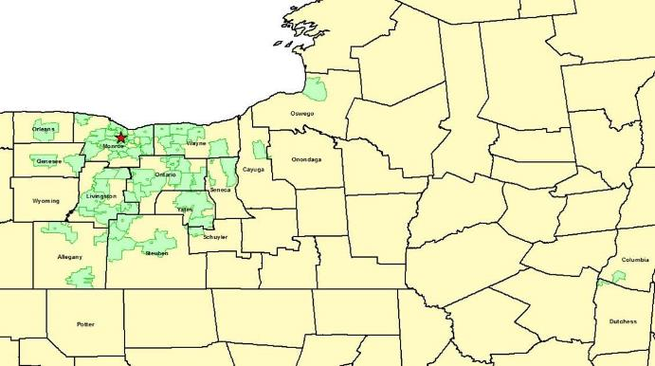
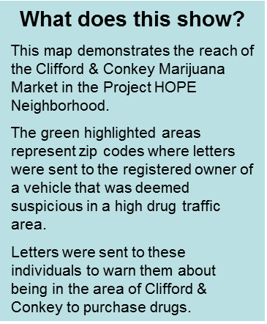

The Reach of Clifford & Conkey
66% of letters were mailed outside
the City of Rochester and hit a total of 14 counties!
Notes:
Information obtained from the RPD Letter Writing Campaign in HOPE Neighborhood; (SHOW VIDEO CLIP ??)
Our current system can be effective… but not with Low-Level sales. Here’s why:
- Decriminalization in NYS; Social Acceptance in community at large; Limited resources to test & prosecute; This leaves the problem on our neighborhoods

Slide 19
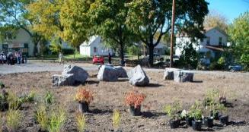
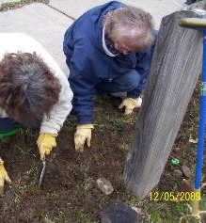
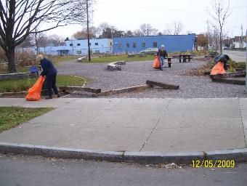
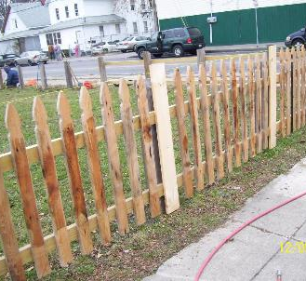
Residents taking back public space
Notes:
Residents believed beyond drugs, they had to take back public spaces in the community. One such space is Clifford & Conkey corner
$100K to build park, residents have done several projects around this corner

Slide 20
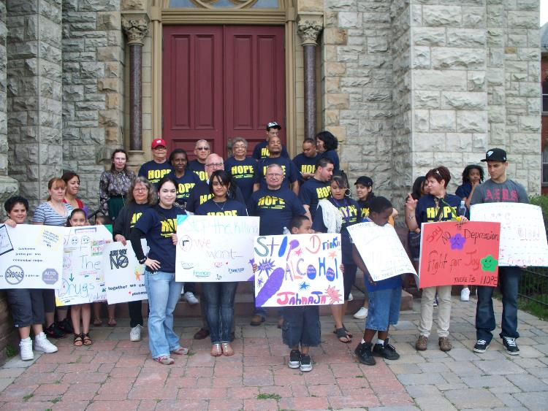
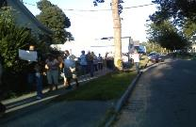
Walking for health in OUR community might look a little different
Notes:
Drug issue head on

Slide 21
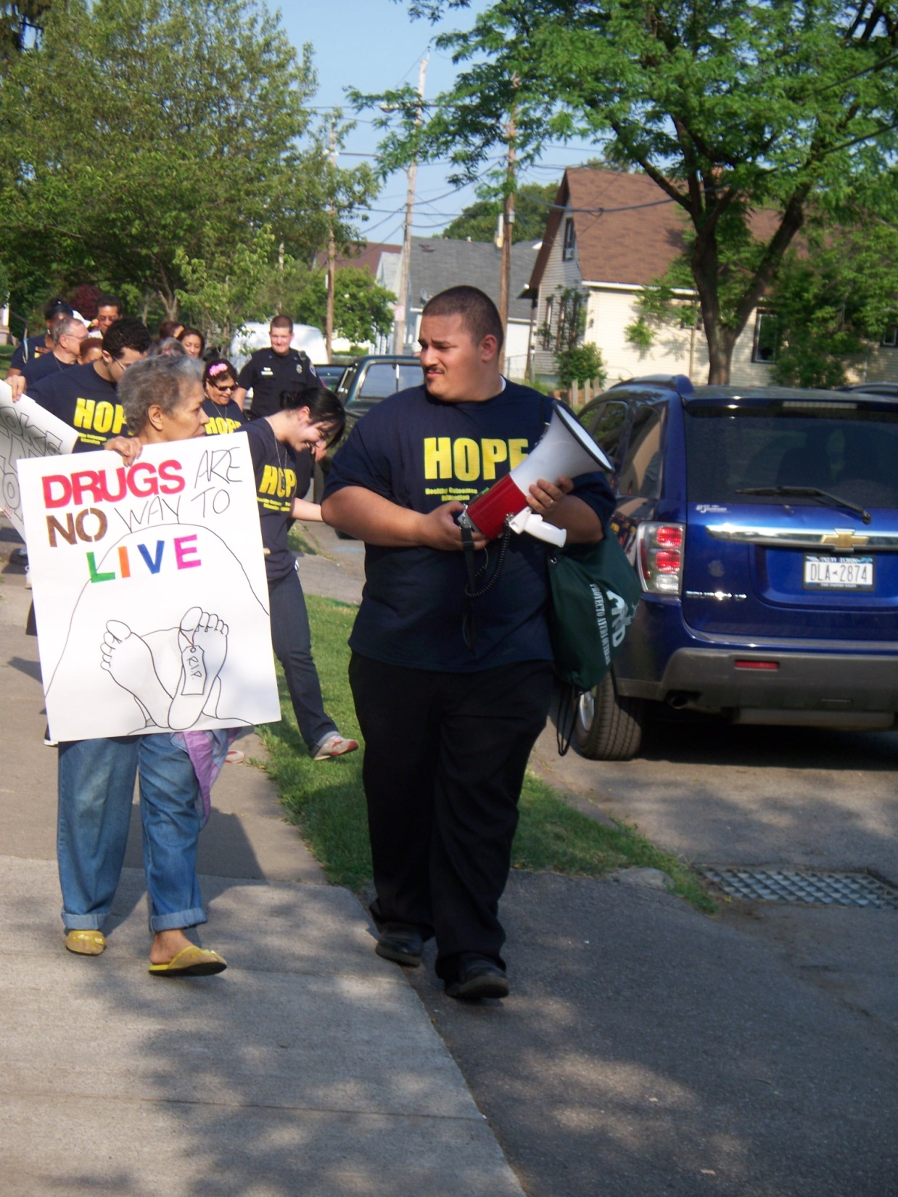
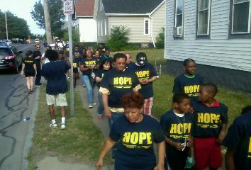
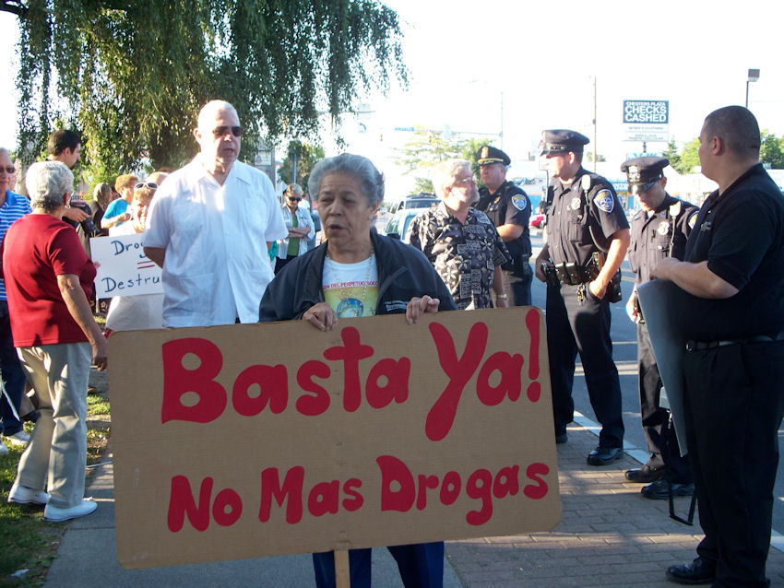
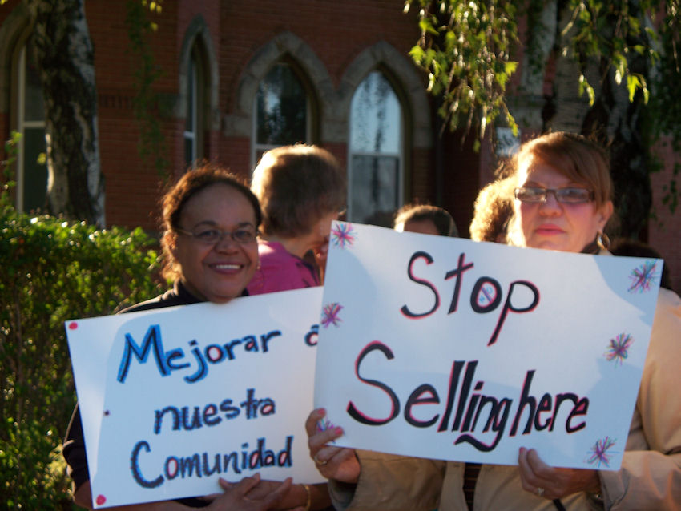
Notes:
Images from walks

Slide 22
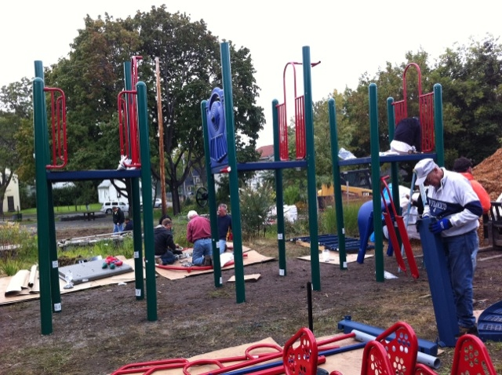
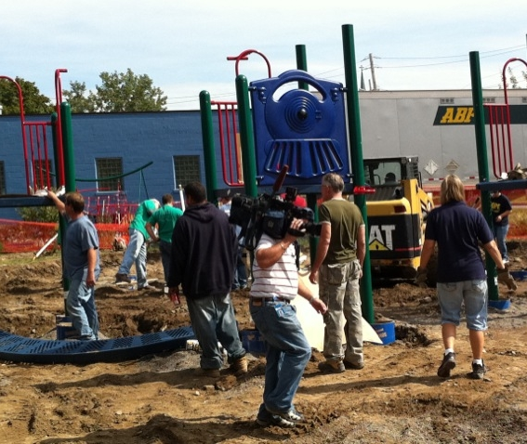
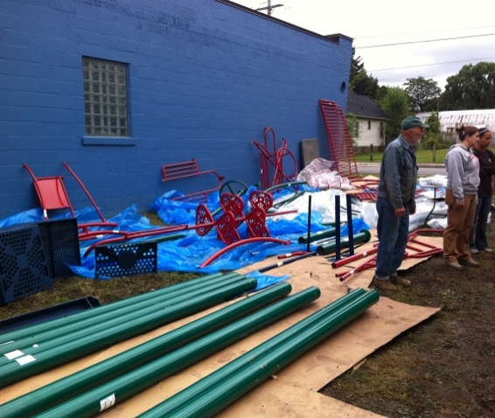
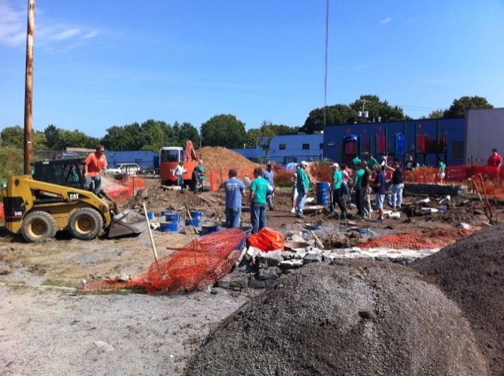
Conkey Corner Playground – Community build

Slide 23
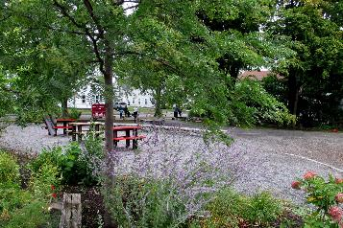
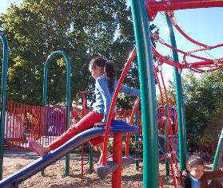
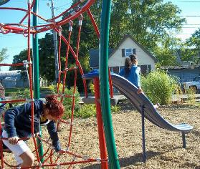
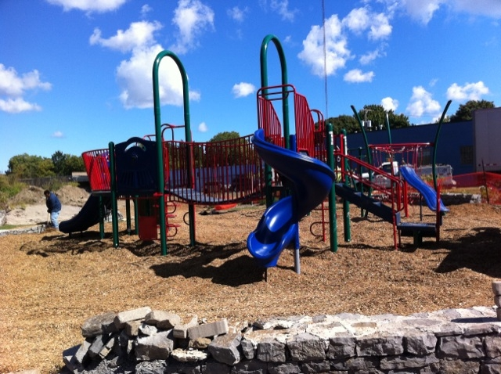
Conkey Corner Park Est. 2008
Playground Est. 2010
Notes:
Pictures were taken days after opening the playground

Slide 24
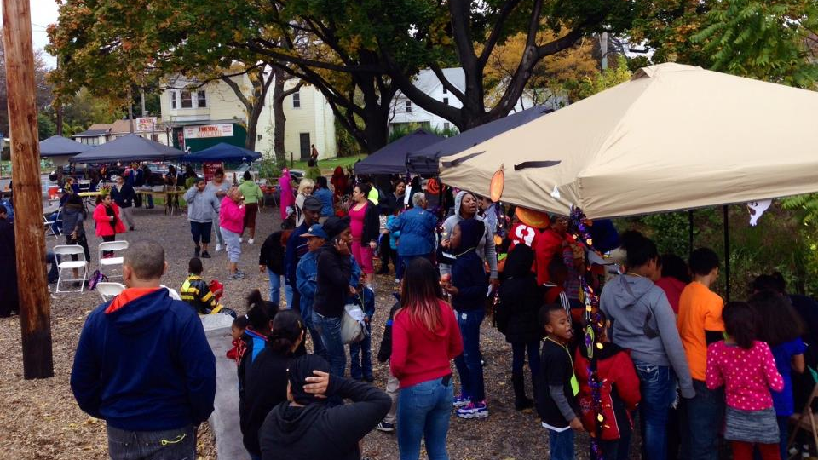
Annual Harvest Festival

Slide 25
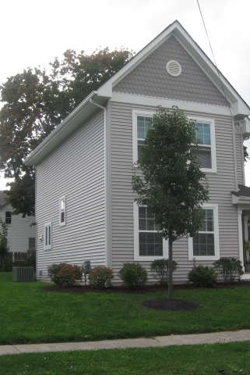
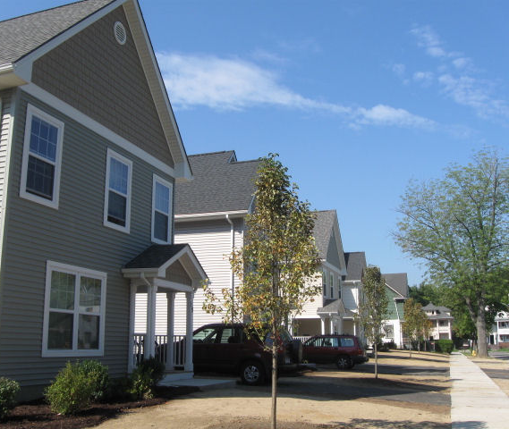
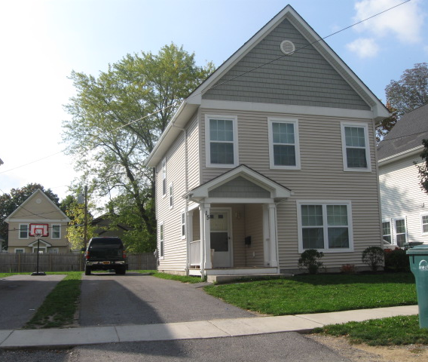
New Development:
El Camino Estates
Notes:
Dramatic difference on Nielson Street

Slide 26
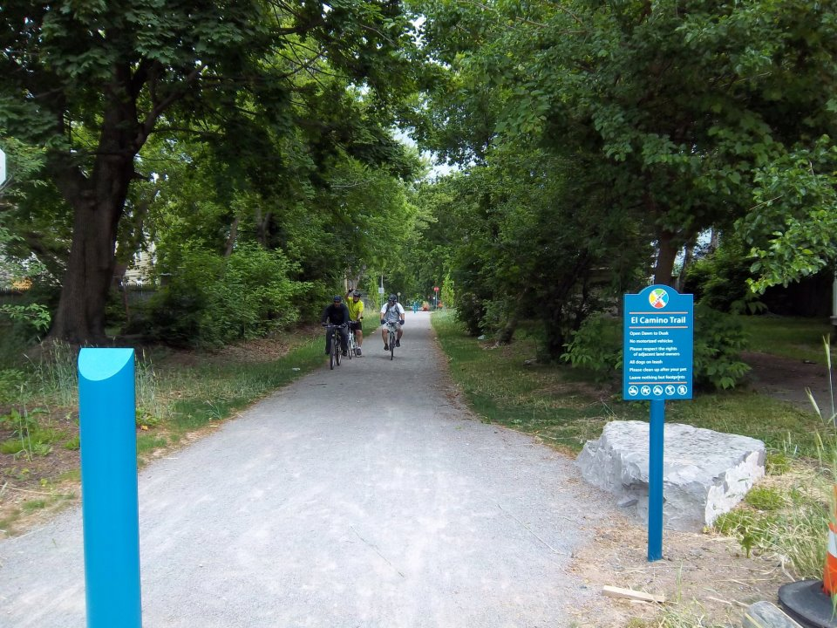
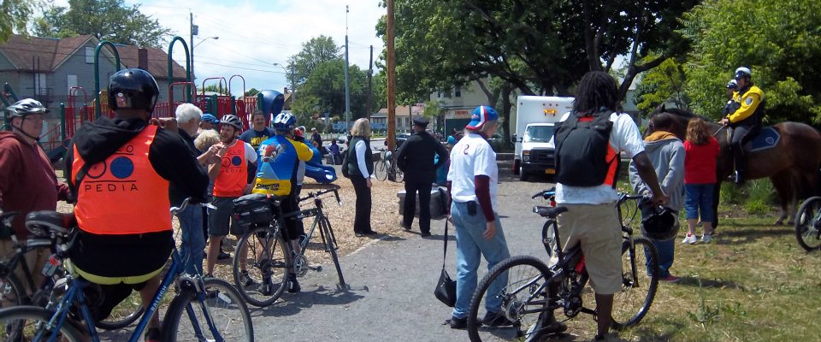
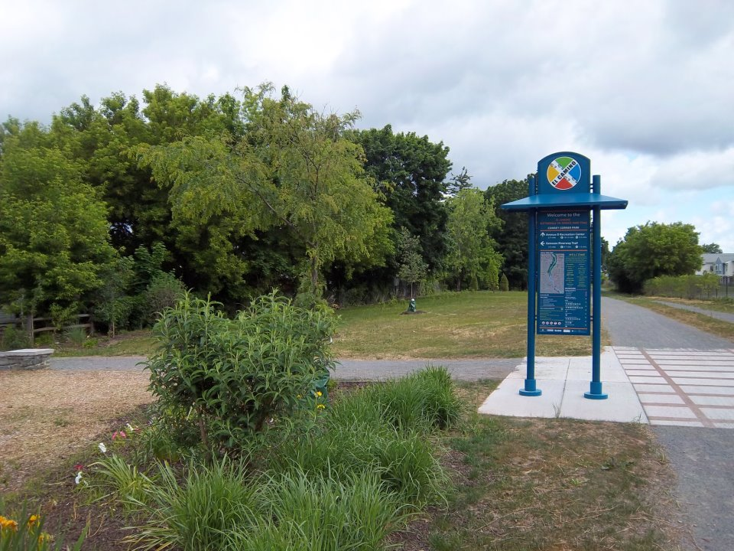

El Camino Trail

Slide 27
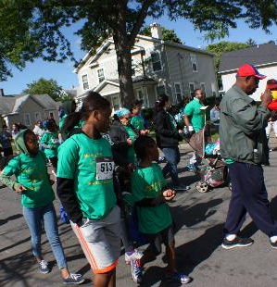

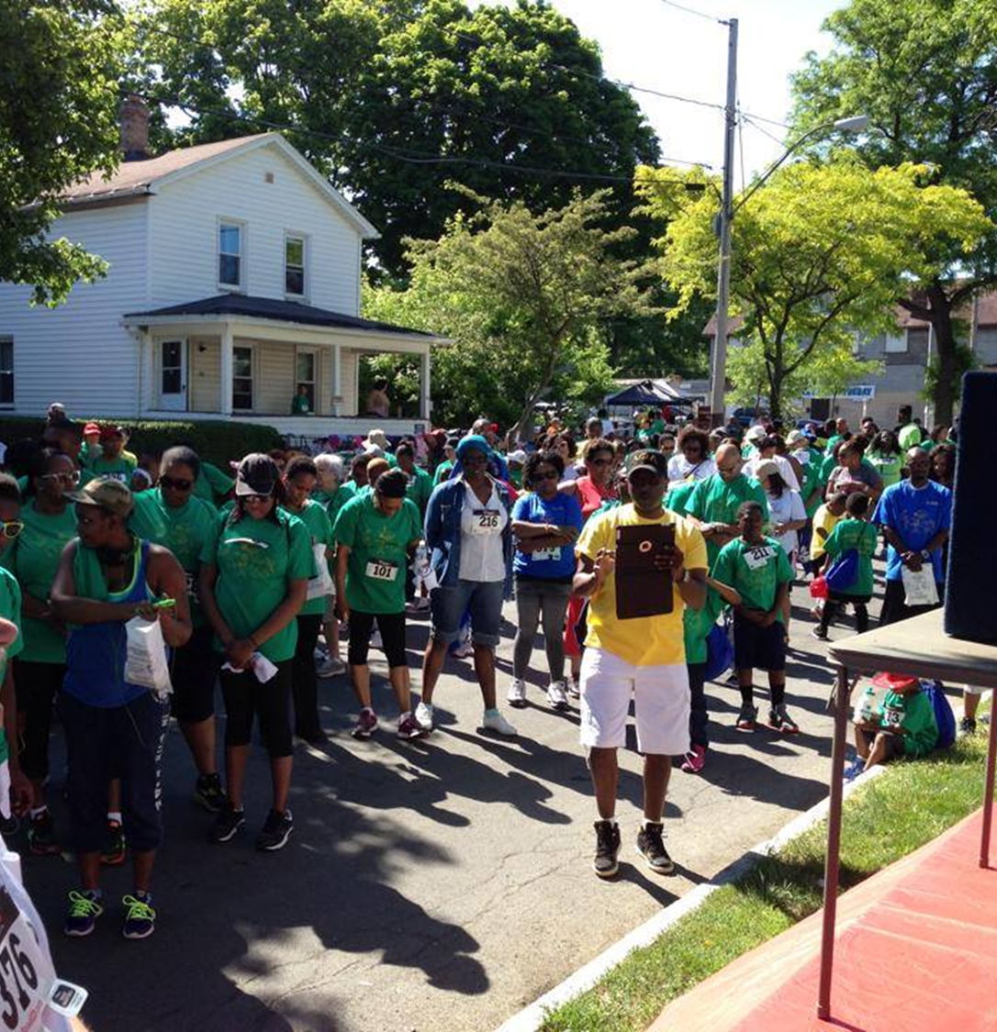
5k Walk

Slide 28
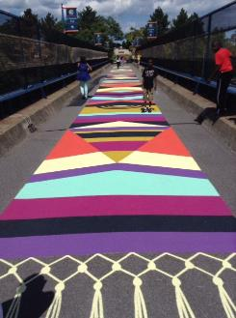
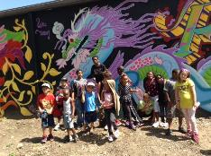
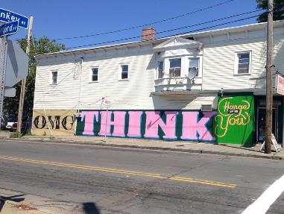
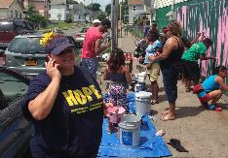
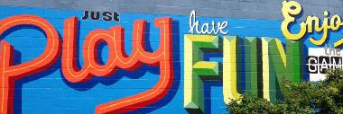
Neighborhood Art

Slide 29
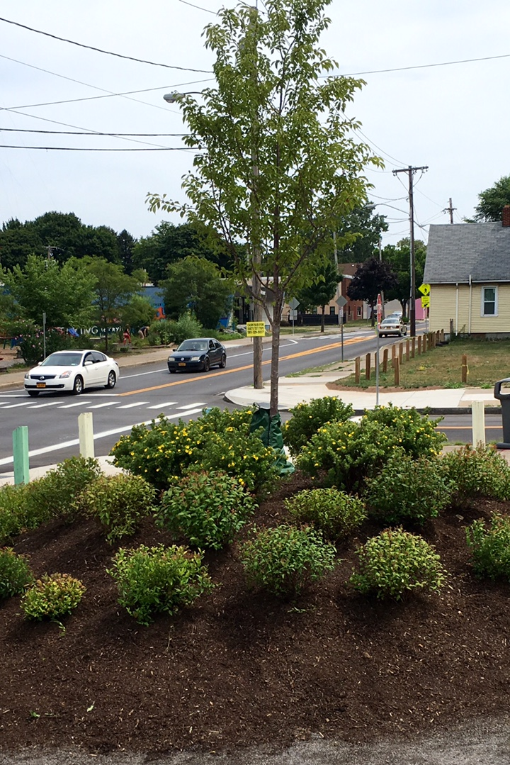
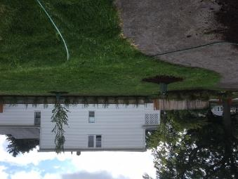
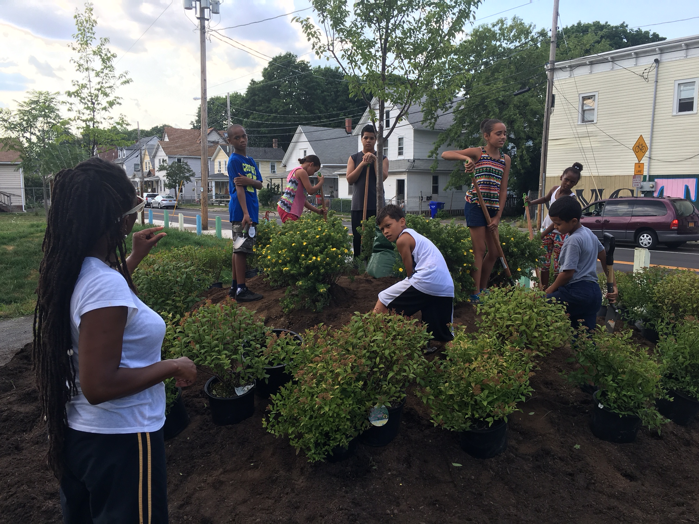
Garden of HOPE –
Est. 2016

Slide 30
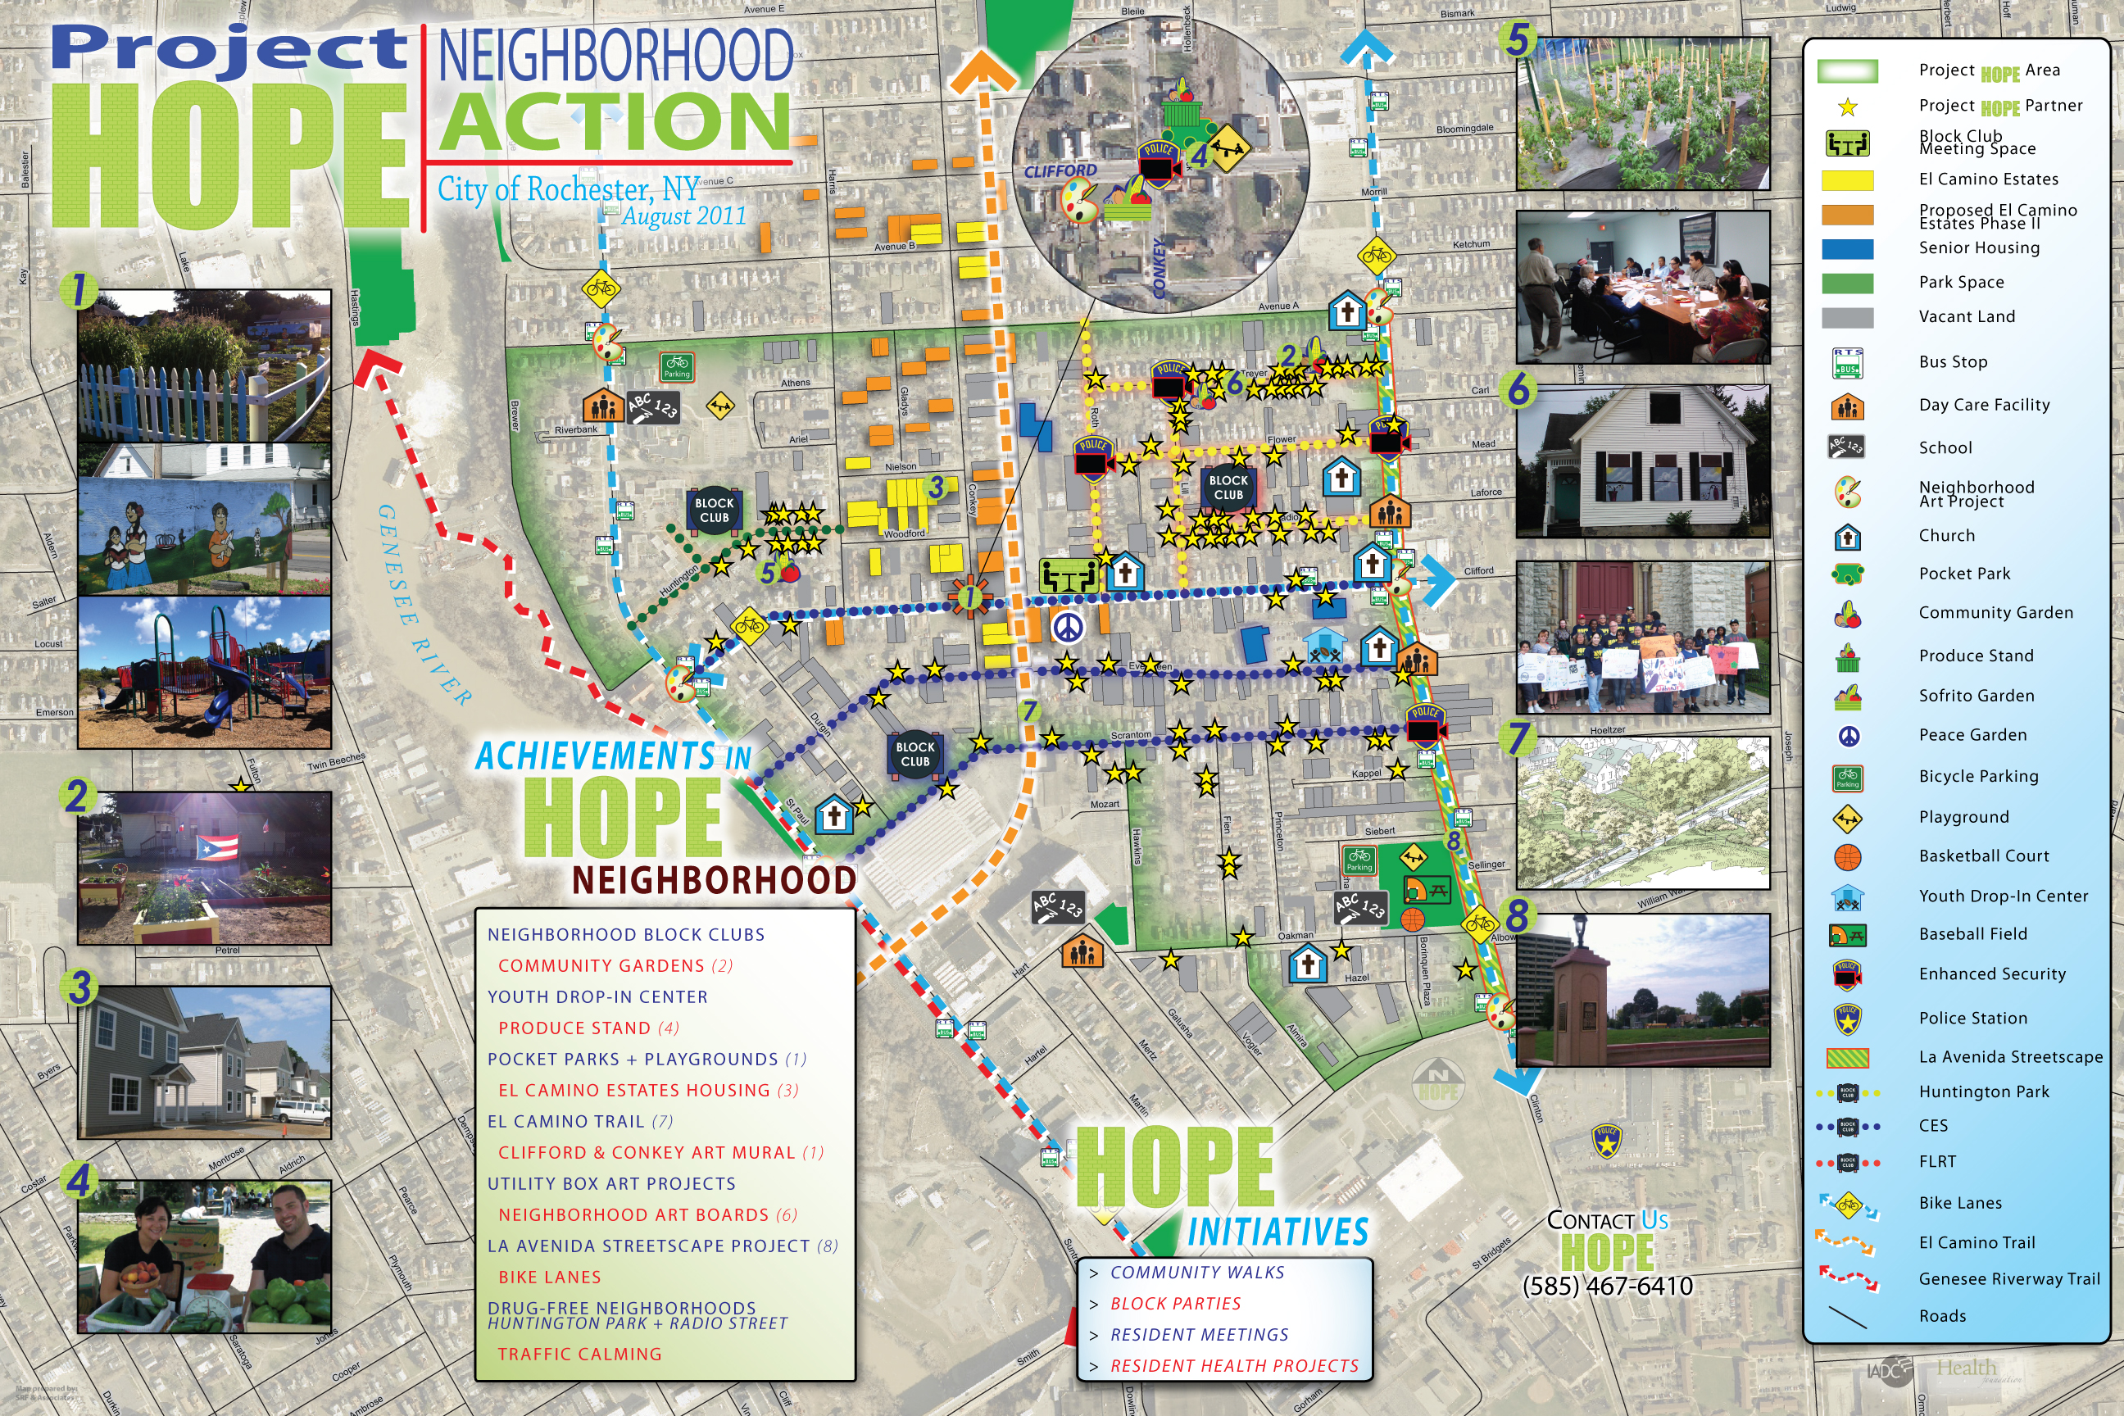

Slide 31
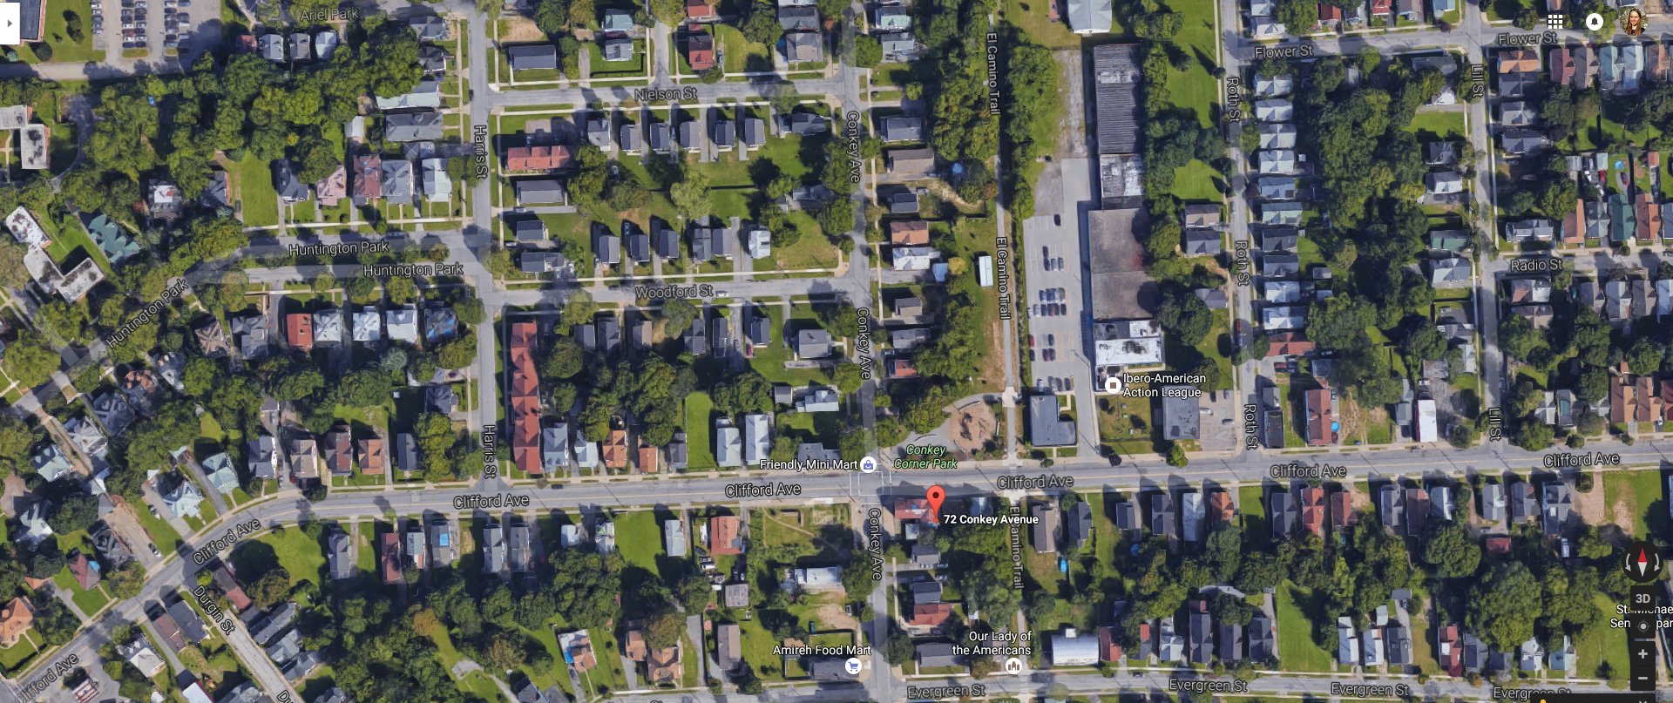
Creating a safe neighborhood through Empowerment and Development

Slide 32
