Slide 1
TAKE BACK THE STREETS
Promoting peace and reducing violence in the Near Westside of Syracuse.
Panel Discussion Healthy Neighborhoods Initiative.
MODERATOR
PANELISTS
Roberto Martinez
Tairina Martinez
Joe Cecile
Lisa Vavonese
Maarten Jacobs
November 18, 2016.

Slide 2
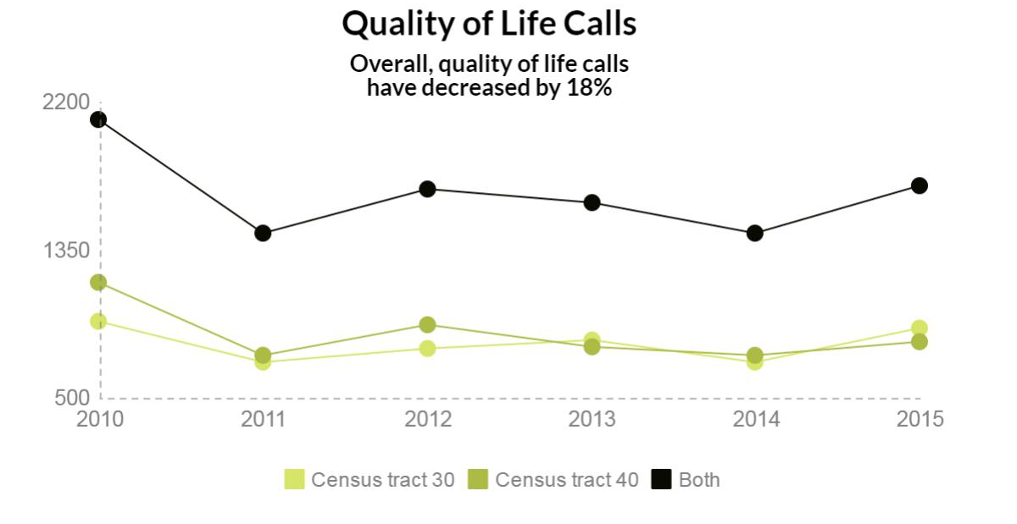
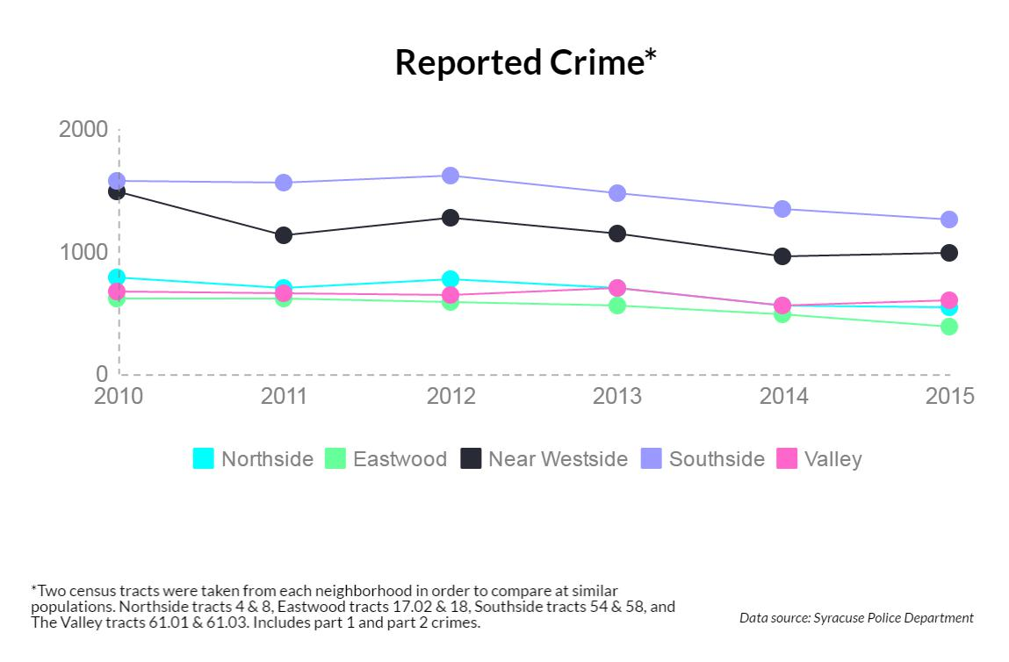
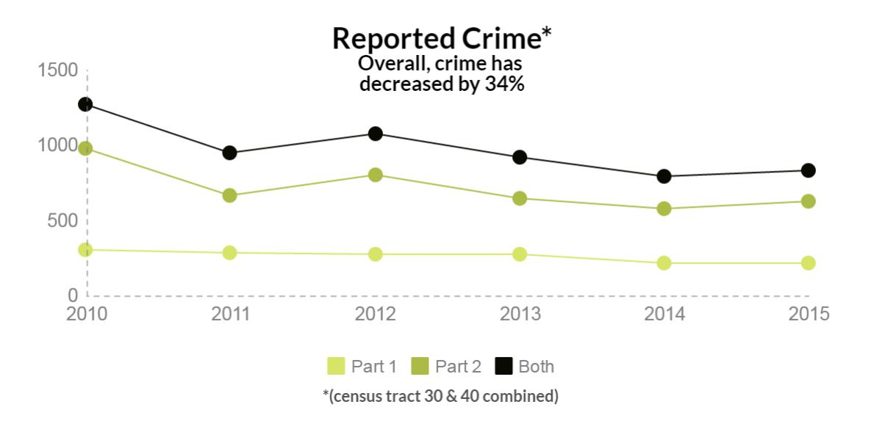
STATS

Slide 3
“
We need to take the streets
back, and have family friendly activities
STRATEGIES
COMMUNITY POLICING
CREATIVE PLACEMAKING
Improve Community Police relationships.
Environmental Improvements.
TRAINING
PEACEMAKERS
COMMUNITY ORGANIZATION
Train community members in conflict resolution.
Increase the community’s capacity to address violence.

Slide 5
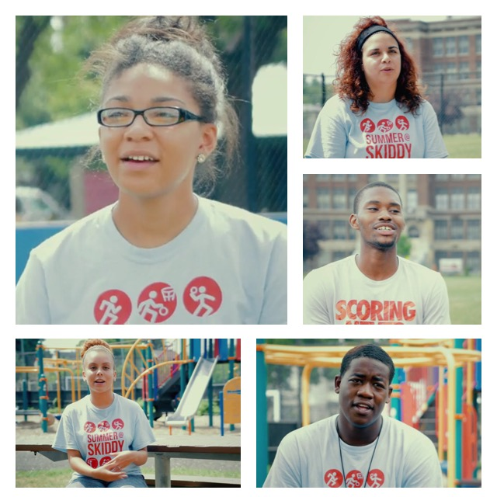
Community’s
Perspective
Tairina Martinez
Resident of the NWS
NWSI Board Member

Slide 6
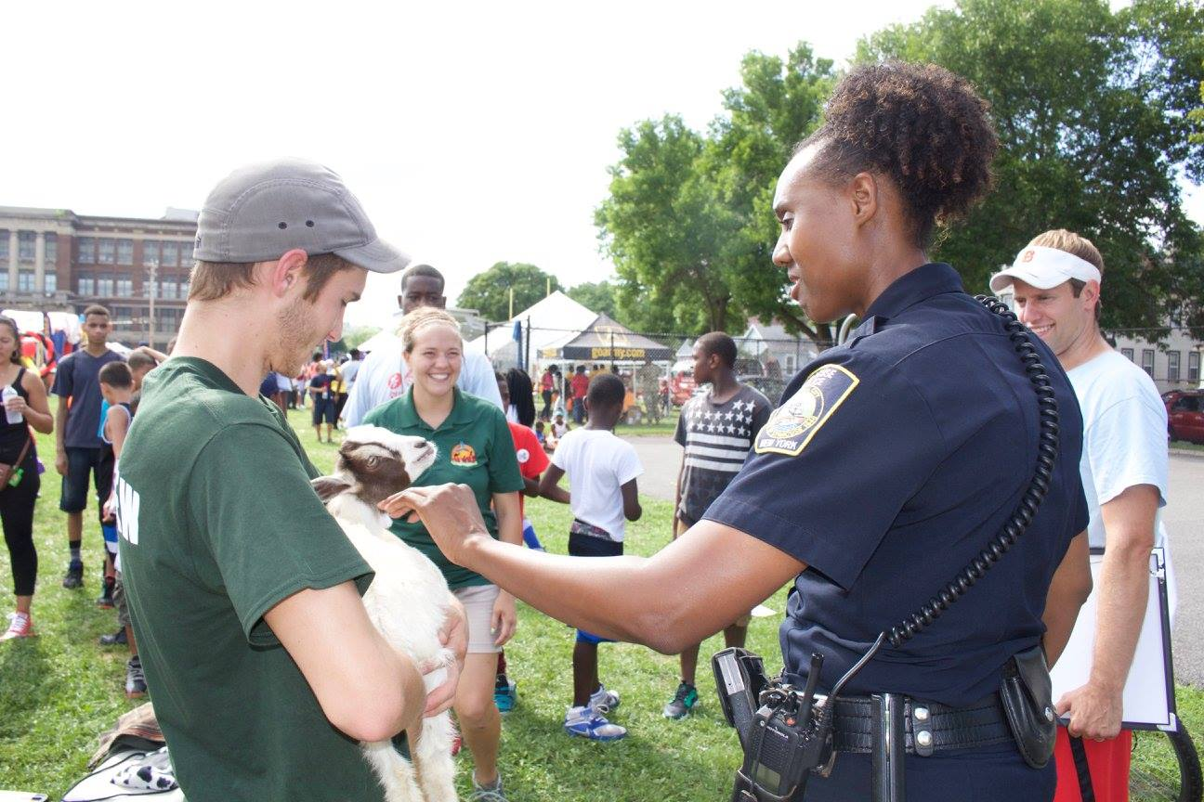
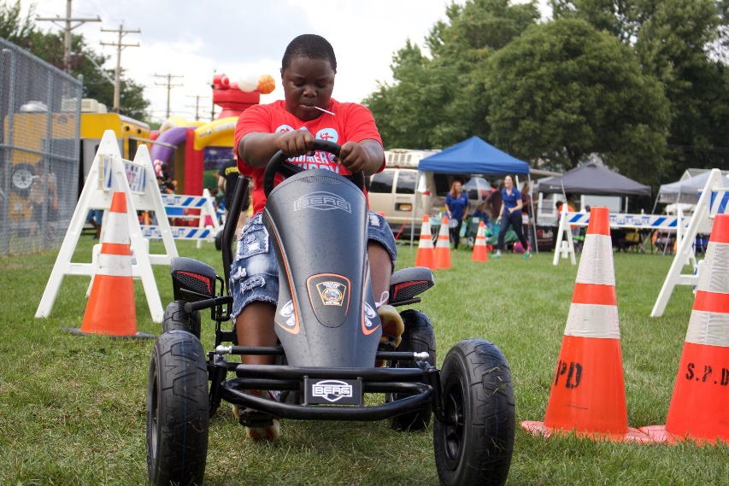
Community
Policing
Joseph Cecile
First Deputy Chief
Syracuse Police

Slide 7
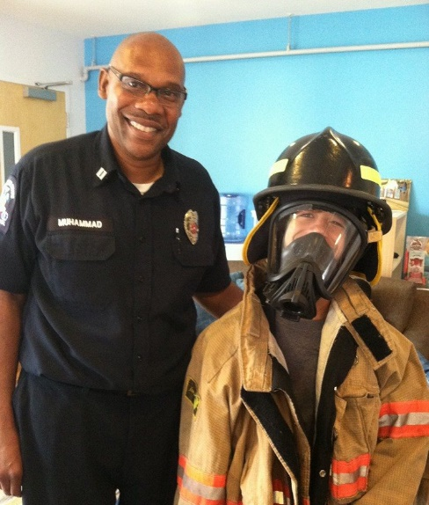
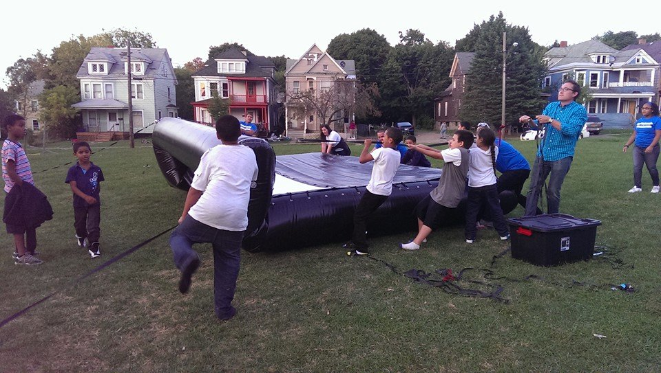
Near Westside
Peacemaking Project
Lisa Vavonese
Peacemaking Center

Slide 8
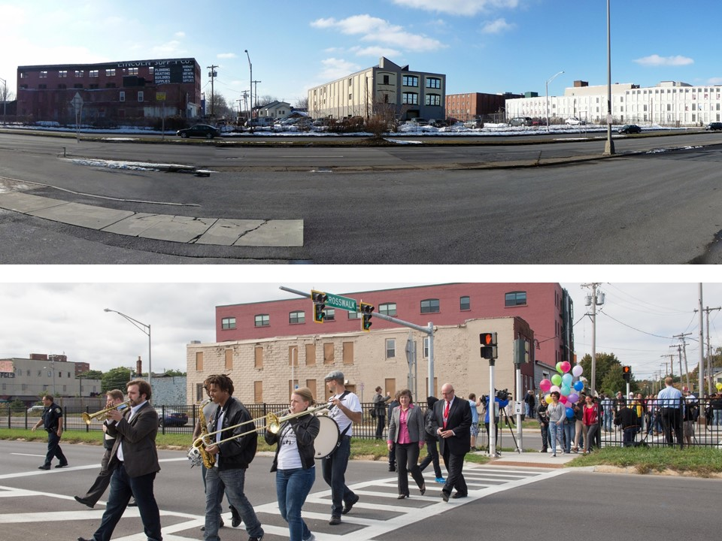
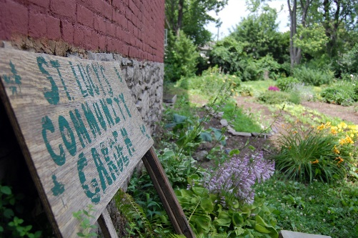
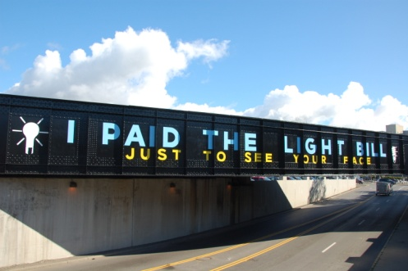
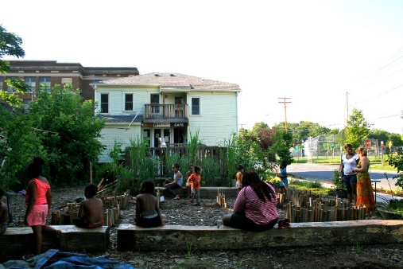
Placemaking &
Environmental
Design
Maarten Jacobs
Executive Director
Near Westside Initiative

Slide 9
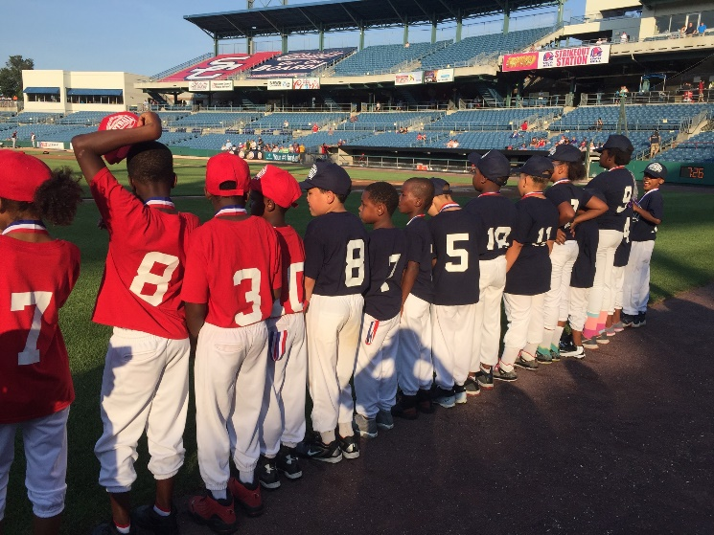
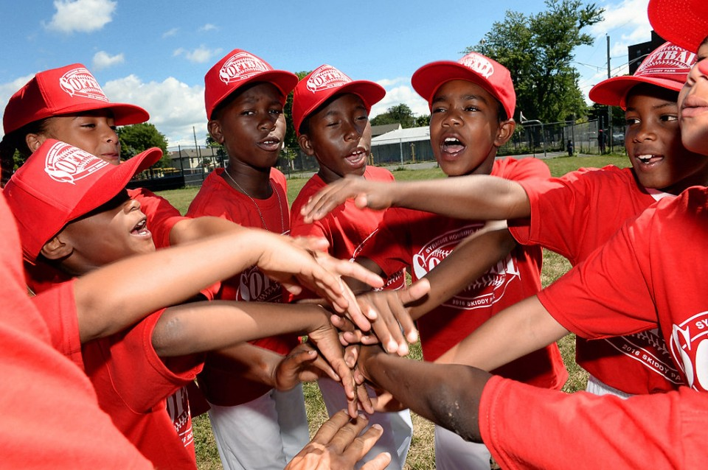
One More Story!
SHA Softball League

