Slide 1
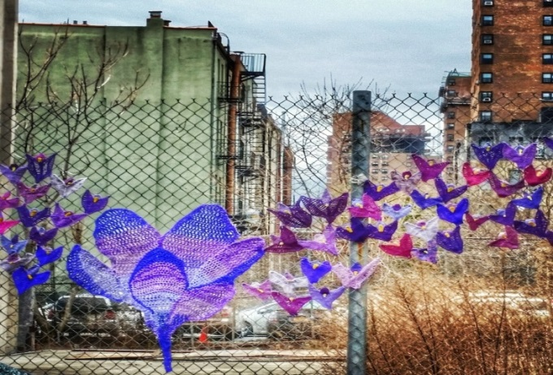
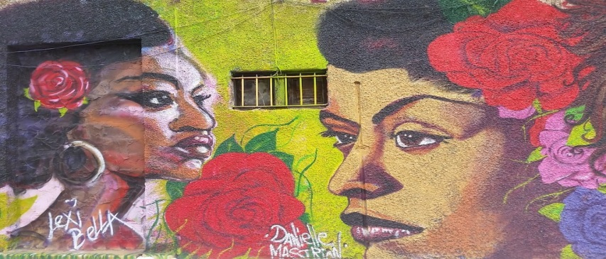
Healthy Neighborhoods Learning Collaborative Meeting
NYC Department of Health and Mental Hygiene
Center for Health Equity
East Harlem Neighborhood Health Action Center
Carmen Diaz-Malvido
Director of Community Engagement and Partnerships
Cinthia De La Rosa
Project Coordinator
Judy Chang
Director of New Initiatives
March 29, 2017

Slide 2
Priority Areas & Goal
Activate, expand, or reframe existing programs, policies, or planning processes with the potential to:
Improve access to healthy and affordable foods
Increase access to the built environment
Link residents to programs that support lifestyle changes
Bolster economic opportunities

Slide 3
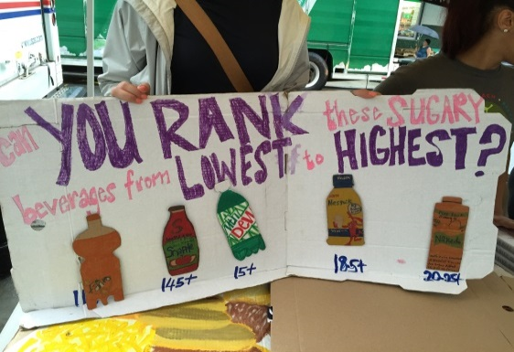
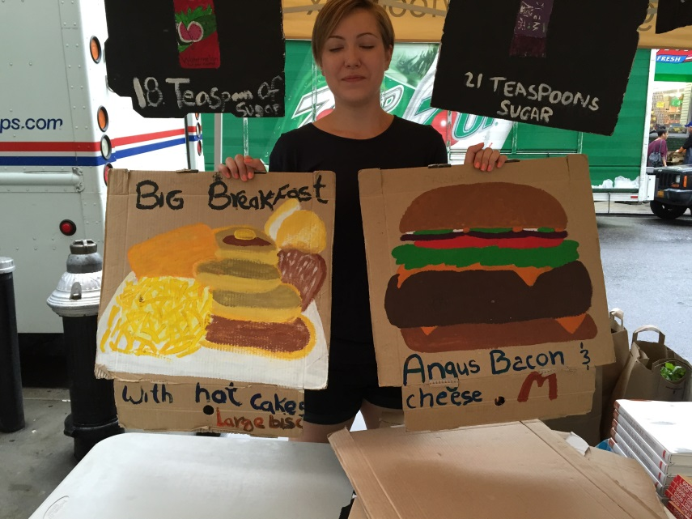
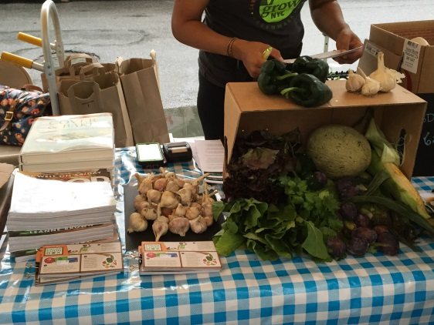
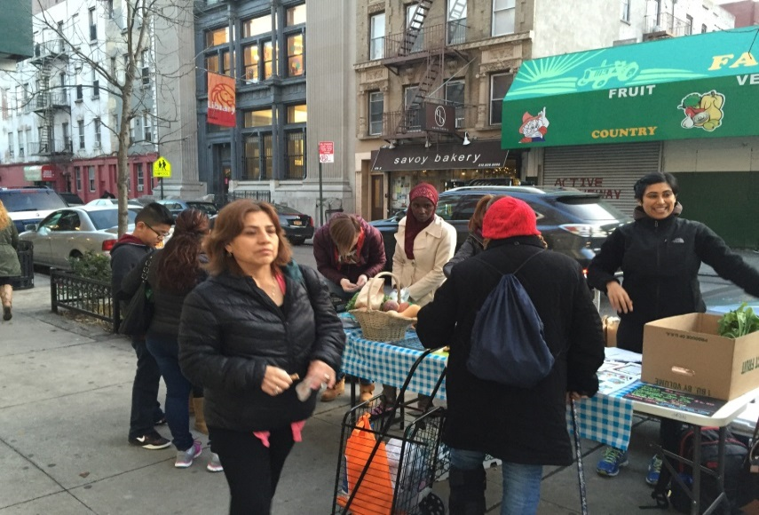
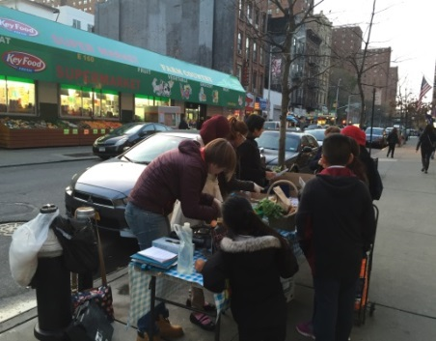
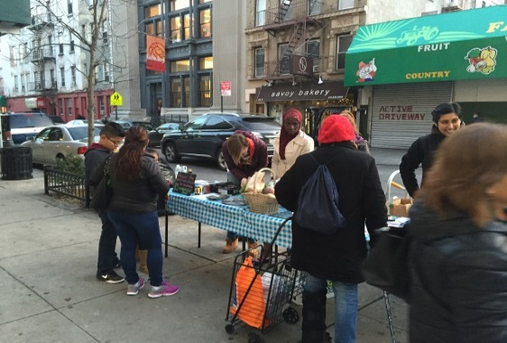
Fresh Food Box
2269 Food Boxes
Distributed
25,729
Pounds
Distributed
Notes:
Since September 2015 to date, we have distributed 2269 food boxes, approximately 25, 729 lbs. of food since July 2015.
Season 2015: 3575 lbs
Winter 2015-2016 : 8360 lbs
Season 2016: 10142
Winter 2016-present: 3652

Slide 4
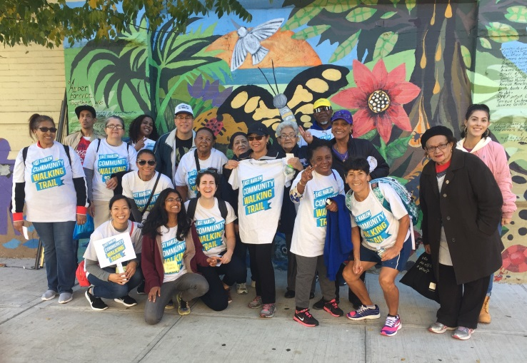
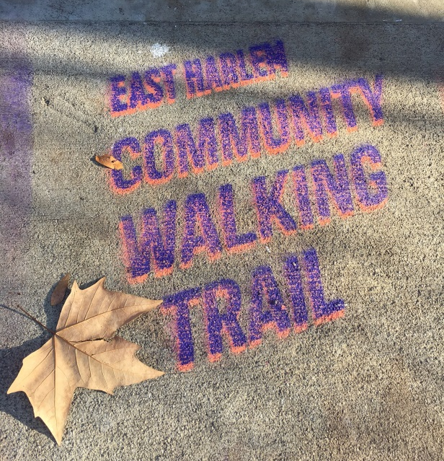
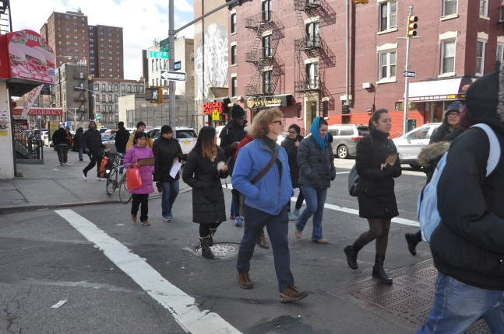
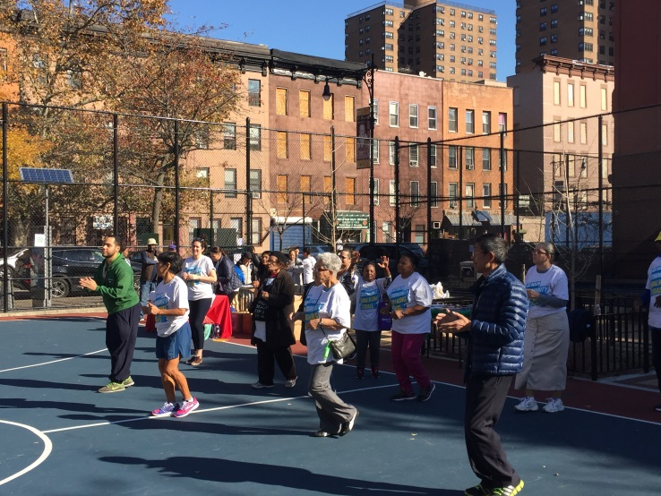
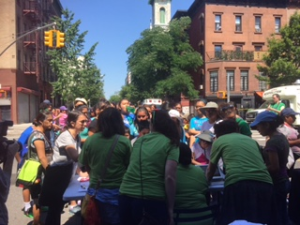
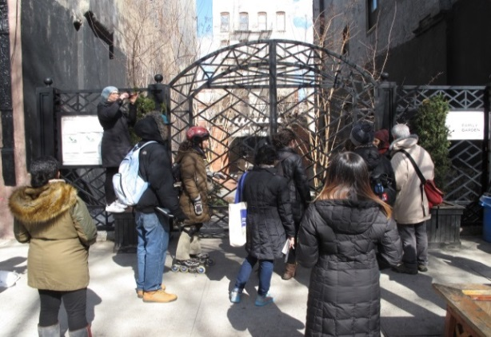
Community Walking Trail
Notes:
East Harlem Community Walking Trail is a 3 mile route that runs east and west along 106th and 115th streets, connecting residents to Central Park and Randall’s Island.
The goals of the trail are to:
Connect residents to physical activity resources,
Highlight the art, rich history, and culture of the neighborhood
Improve safety through coordinated group walks.

Slide 5
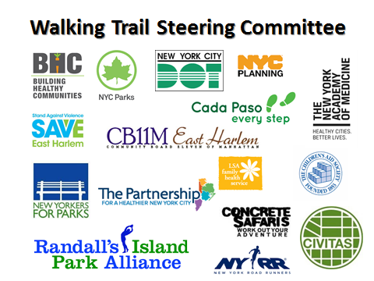
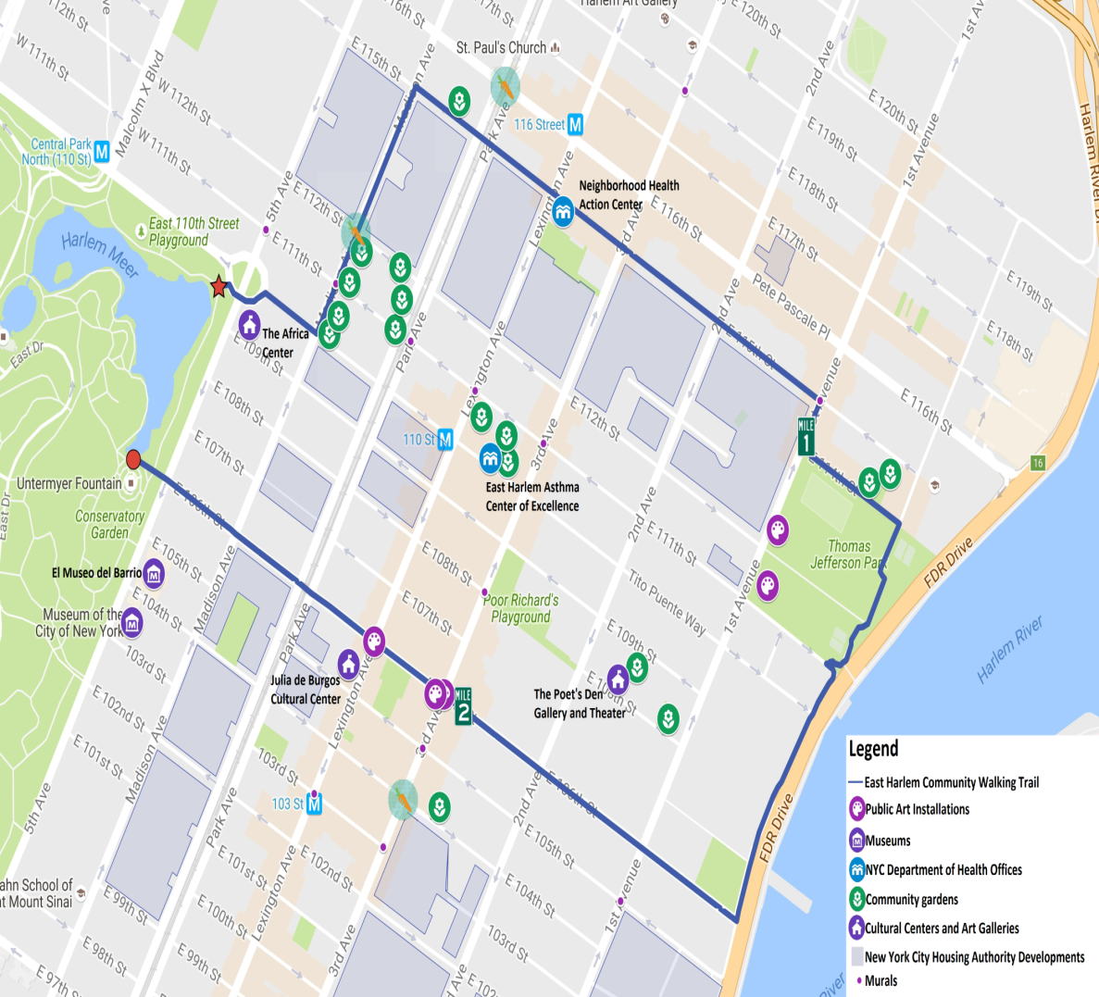
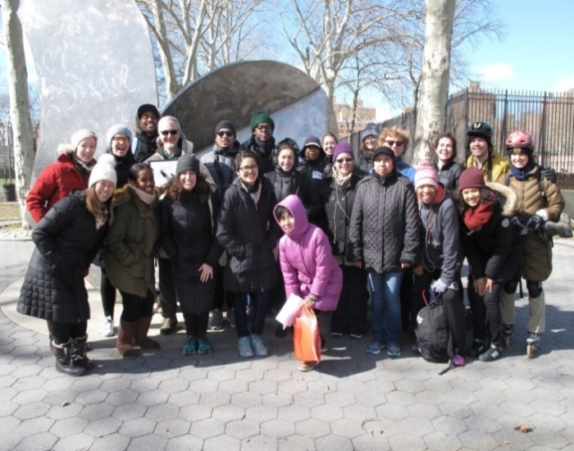
Community Walking Trail
Notes:
The steering committee convenes monthly (usually the 2nd or 3rd Friday of the month) 12pm-1:30pm to discuss updates and share opportunities for collaboration. This group has been integral in shaping the project. They have voiced their concerns and have brought residents to decide on the route and provide feedback.

Slide 6
Community Walking Trail
Notes:
Conducted 22 street assessments along the Community Walking Trail. We measured Pedestrian crossings, Sidewalk maintenance, Amenities and Resources
Beautification / Amenities:
13 Benches along the trail
Applying for a bench is relatively quick; it takes about 6 months or so to get approved and installed.
Dog Waste:
2 out of 3 respondents see dog waste often while walking
Dog waste was found 38 times on 10 segments
Resources:
31 along the trail

Slide 7
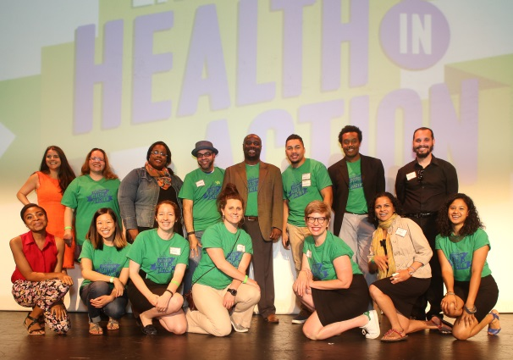
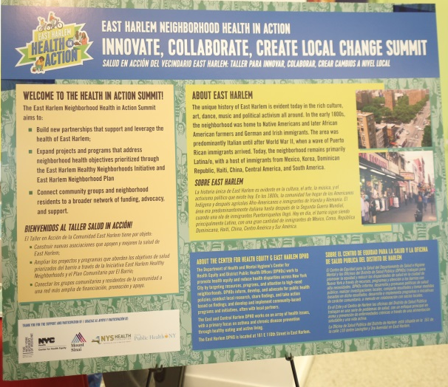
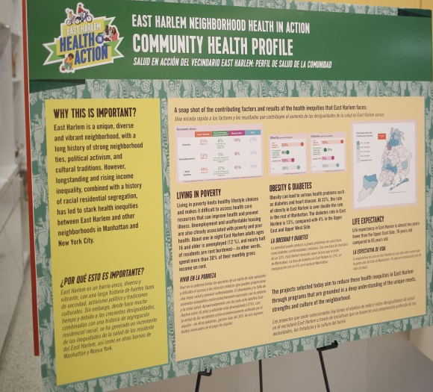
Health In Action Summit
Notes:
On June 11th 2016 the East Harlem Neighborhood Health Action Center facilitated the Health in Action: Innovate, Collaborate, Create Social Change Summit, a collaborative process to:
Build new partnerships and alliances that support and leverage the health of East Harlem;
Support the creation and expansion of projects and programs that address neighborhood health objectives prioritized through the EHNP and the EHHNI; and
Connect community groups and neighborhood residents to a broader network of funding, advocacy, and support.
The East Harlem Neighborhoods Health Action Center allocated $225,000 to 9 CBOs selected by a panel of 10 residents serving as judges for the day. The panel reviewed all RFPs and deliberated on the outcome of the grantees.

Slide 8
Top Accomplishments
Convening a panel of residents to participate in the Health in Action Summit
Disseminating $275,000 in seed funding to 11 CBOs to activate short-term projects in East Harlem
Launching the East Harlem Walking Trail and Week of Walking Challenge (663,728 steps about 314.26 miles)
Connecting community groups to funding to activate the walking trail, open and public spaces.
Notes:
State of our streets as an advocacy tool

Slide 9
Lessons Learned
It is important to recognize that neighborhood work requires a lot of time, energy and resources.
Aligning efforts with community partners and with neighborhood planning processes may seem practical but also takes time and a lot of community buy-in.

Slide 10
Key Challenge
Acknowledging that the Food Box program may be reaching some community residents but not our priority population– how do we ensure that we address food insecurity issues experienced by the most vulnerable people?
Question
What are some potential alternative models for addressing food insecurity among vulnerable populations?

