Slide 1
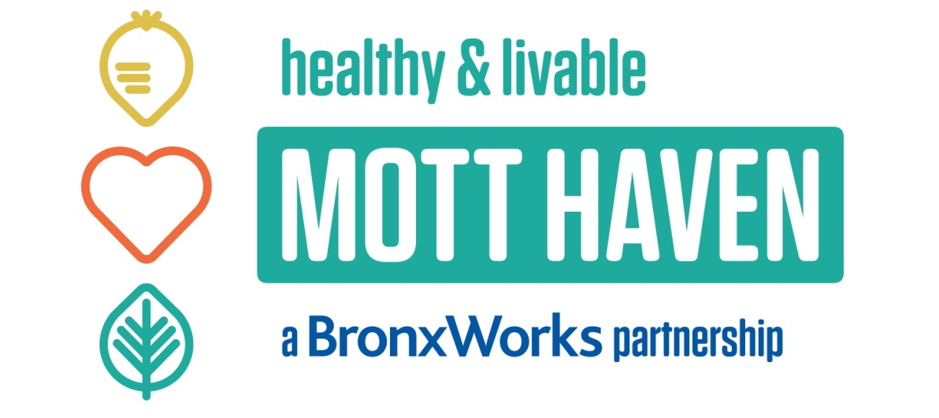
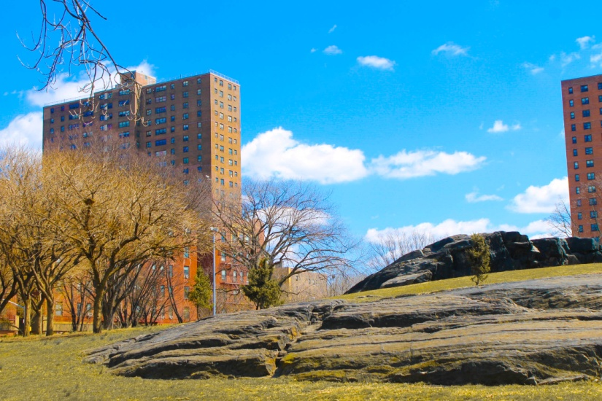
Healthy Neighborhoods Learning Collaborative Meeting
Wednesday, March 29, 2017
Kim Wong, MPH
Program Director

Slide 2
HLMH Partnership Catchment Area

Slide 3
Collaborating Partners
Friends of St. Mary’s Park

Slide 4
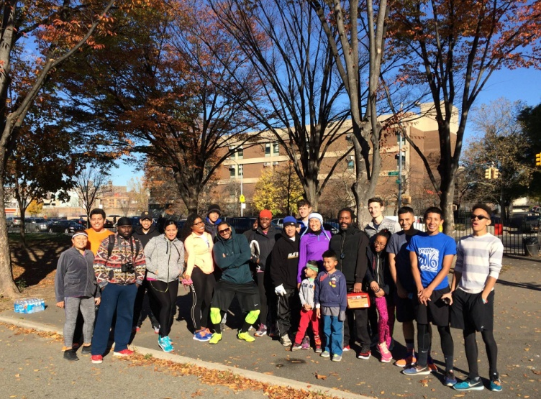
The Vision: a Healthy and Livable Mott Haven
Notes:
Residents will enjoy abundant, affordable nutritious foods; myriad opportunities for physical activity; clean, safe open spaces, and a thriving social connectedness in their community
Farmers’ Markets are well utilized and bodegas will offer healthier options
Residents will have the confidence and skills to shop for and prepare healthy food on a budget
St. Mary’s Park will see physical improvements such as more vegetation, improved seating areas, and art installations, as well as increased fitness, stewardship, and cultural programming that is well-loved by community residents.

Slide 5
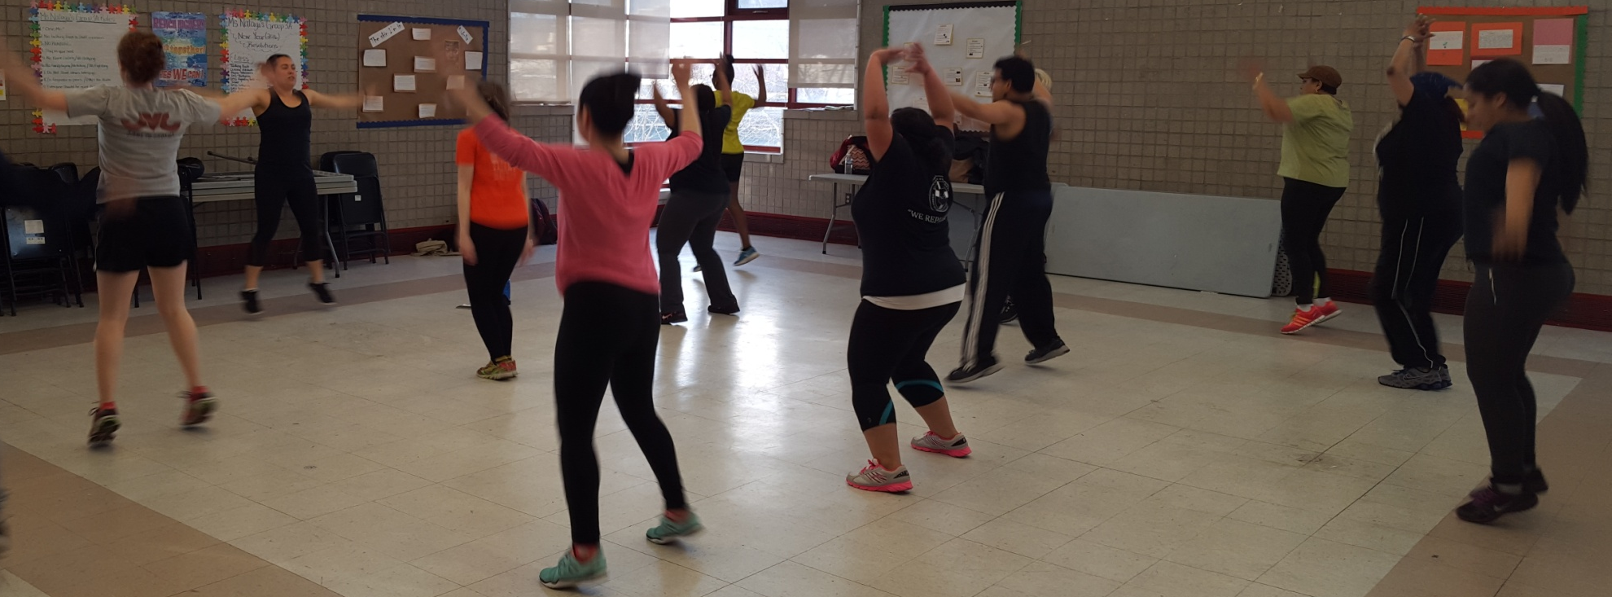
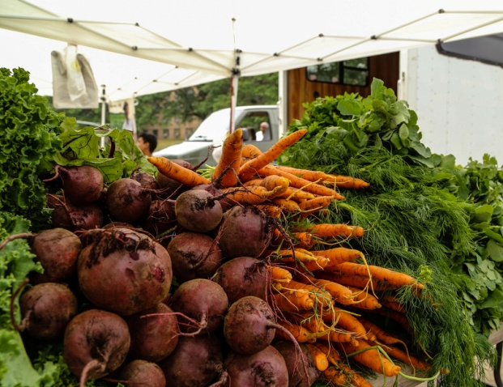
Program Goals
Increase access to healthy food options and opportunities for active living
Increase knowledge, awareness, and utilization of healthy food options and opportunities for active living
Strengthen community capacity to collaboratively promote healthy eating and physical activity
Notes:
To realize the vision, these are our more concrete attainable goals.

Slide 6
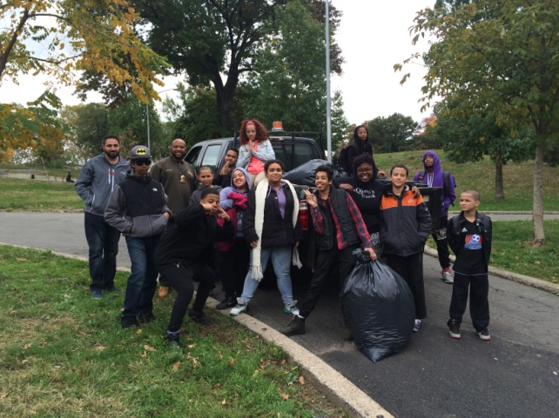
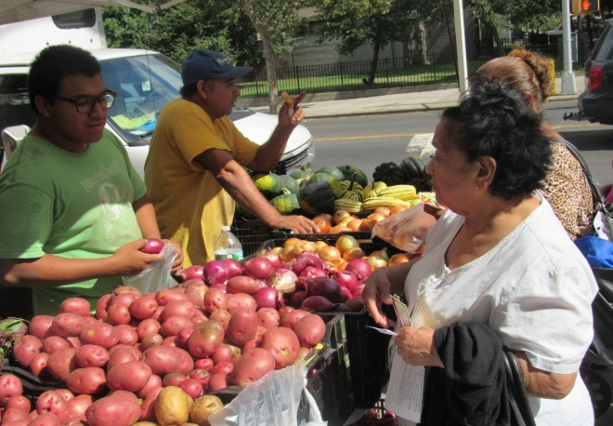
Program Strategies
Collaboration and Community mobilization
Healthy Eating
Shop Healthy
Community Food Tours
Nutrition Education
Active Living
Park Stewardship
Fitness programming
Arts and Culture
Activation of Open Spaces

Slide 7
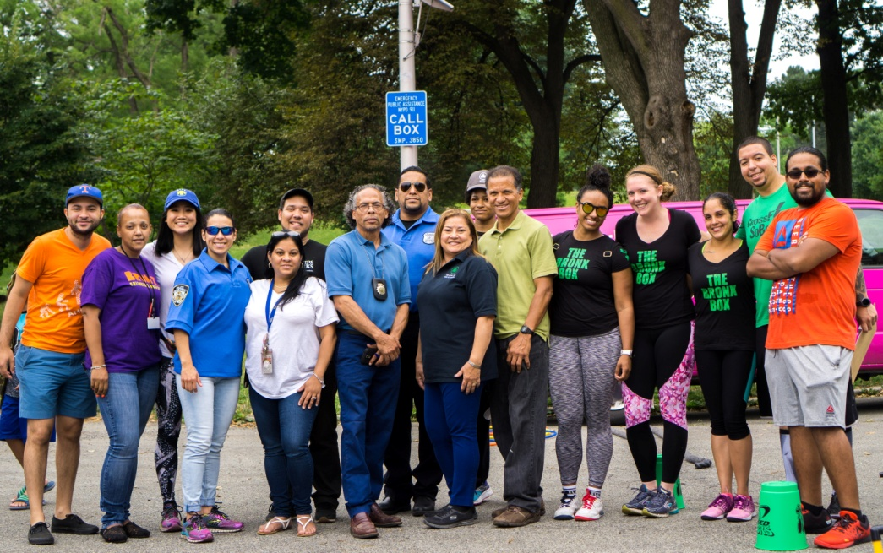
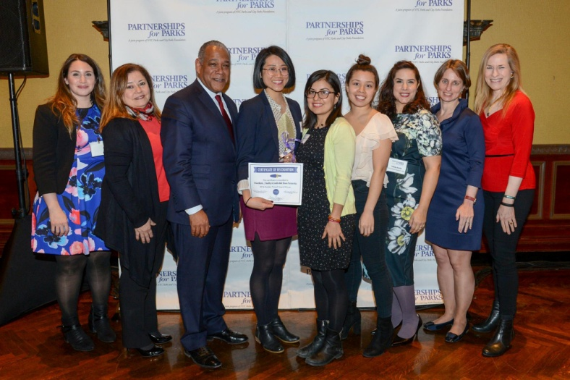
Top Accomplishments – St. Mary’s Park
Founded the St. Mary’s Park Workgroup in late 2015 made up of over 20 community partners
Activated St. Mary’s through the Second Saturdays event series bringing in 955 participants into the park
Anchor Parks - $30 million in capital improvements
2016 Golden Trowel Award to BronxWorks and HLMH
Notes:
Farmer’s Markets
Shop for local produce
Cooking demonstrations
Health Bucks
Emergency Food
Food Pantries
City Harvest Mobile Market
Community Gardens
Learn gardening tips
Composting
Cooking Matters® at the Store
Learn food budgeting tips at the grocery store
Reading food labels
Bodegas and Restaurants
Highlighting healthy options
Know what to order if you have diet restrictions
Shop Healthy NYC Bodegas
Incentives for participants
If you would like to have a group from your organization participate in a community food tour please contact me.

Slide 8
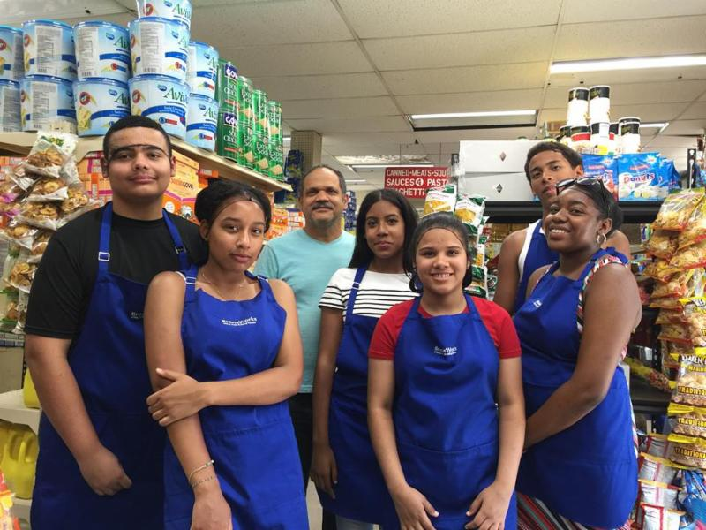
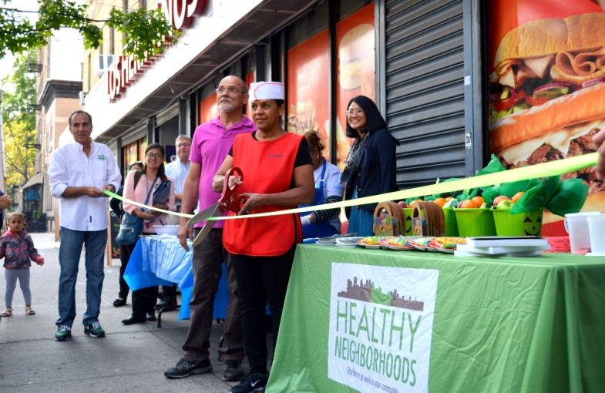
Top Accomplishments – Shop Healthy!
BronxWorks Shop Healthy Team adopted 3 partner stores in 2016 and are the stores are meeting Shop Healthy criteria
Through City Harvests’ Healthy Retail Program, our partner stores got new refrigeration units for fresh produce!
Youth program has engaged 30 youth to become agents of change through CHEFS for Change Program
Notes:
One of our ongoing programs is with the implementation of Shop Healthy NYC at some of the Bodega’s in Mott Haven.
We are also helping some of these stores partner with City Harvest to come in and update their produce section.
Our Shop Healthy Bodega’s will also be a part of the community food tours – participants will learn about the healthy deli Special that is offered and how to look for the signs to let them know, for example, if it is a whole grain item or a healthy snack.

Slide 9
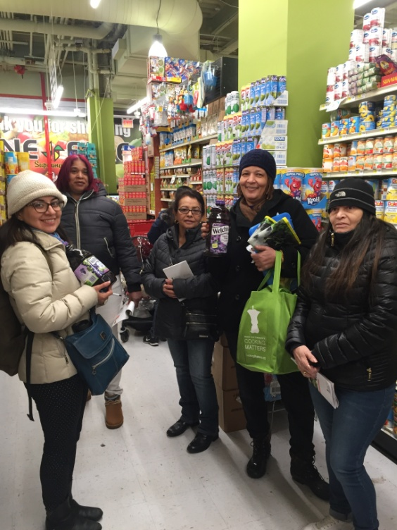
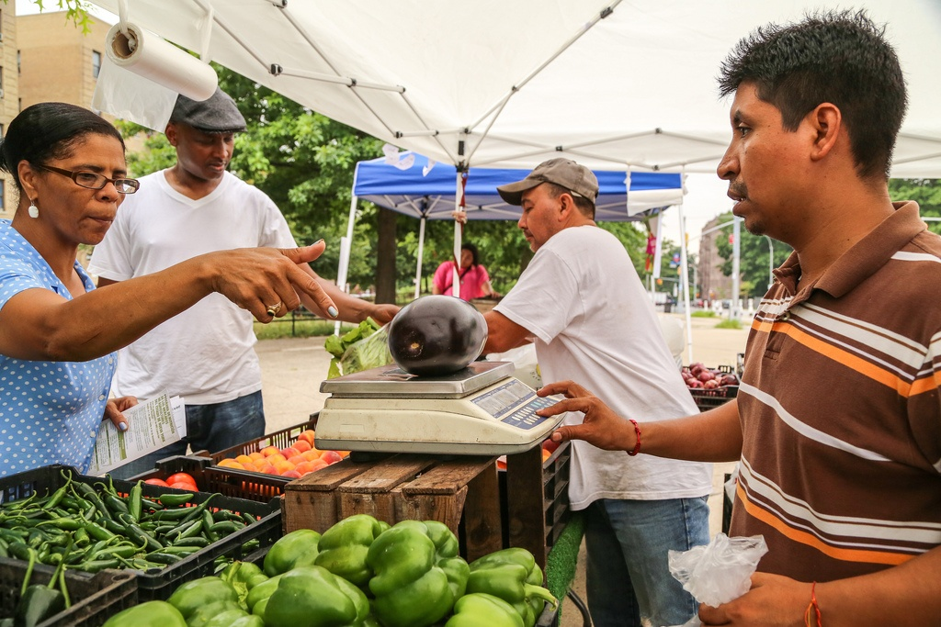
Top Accomplishments – Community Food Tours
Conducted 11 Grocery Store Tours and 38 Farmers Market Tours reaching 401 participants

Slide 10
Lessons Learned
We are thinking beyond providing services at how multi-sector, cross collaborative approaches can have great impact and applying this across other programs at BronxWorks
Collaborative work is not easy when there are many moving parts and different program components
Open and honest communication is important. Through new, trusting relationships we can truly collaborate

Slide 11
Key Challenge
Now that programs are being implemented, we face the challenge of assessing whether our programs are effective and meeting the needs of the Mott Haven community. What are we doing well and what do we need to improve on?
How do we continue to keep partners engaged and avoid “meeting fatigue”?
Question

