Slide 1
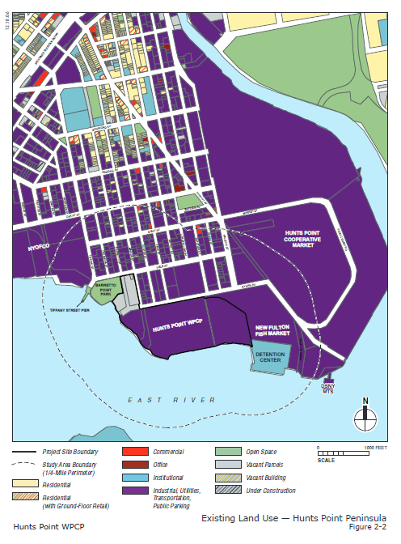
Healthy Neighborhoods Learning Collaborative Meeting
Insert map here
Urban Health Plan, Hunts Point Yineska Guerrero, Project Coordinator
March 29, 2017

Slide 2
Cross Sector Partners and Collaborators
DOT- Division of Transportation Planning and Management
Activation of public spaces in the Hunts Point Peninsula
NYC-DOHMH Center for Health Equity
Hunts Point Alliance for Children
NY Restoration: Haven Project
New York City Economic Development Corporation
Hunts Point Resiliency Project
Greater Hunts Point Economic Development Corp (GHPEDC)
Partnership with the Hunts Point Market
Focus on improving businesses and workforce development in the Hunts Point community
Hunts Point M.S. 424
School Based Health Program
Promote Health education services to students & parents
Promote Shop Healthy initiatives to the school community
Notes:
Shout out to Bella I and II
Project HOPE

Slide 3
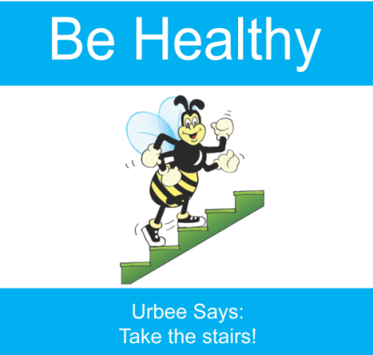
Long-term Goal
Develop a facility open year-round that will provide access to fresh produce as well as create opportunities for local entrepreneurs. It will include a communal space to hold business development/entrepreneurial classes, exercise activities, information sessions and events.
Support a healthy and vibrant community in collaboration with community residents to improve quality of life
Short- Term Goal
Increase access and activate open spaces.
Increase community engagement and create opportunities through the use of the built environment by hosting, placing and creating play streets, Weekends Walks and Bronx Playces

Slide 4
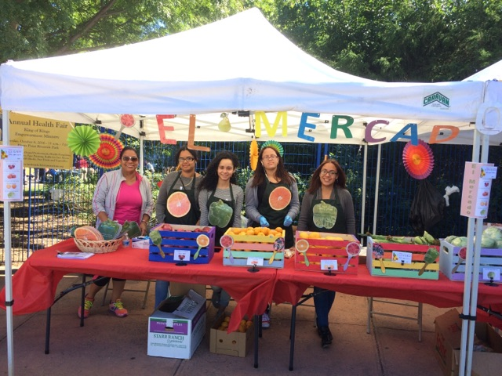
Top Accomplishments
Increased access of affordable fruits and vegetables and opportunities for healthy eating
Shop Healthy Bronx Program
GrowNYC’s Food Box Program
Pop-up Markets
Harvest Home: Farmer’s Market in Monsignor Raul Del Valle Square
#Not 62 – IHEAL Campaign The Bronx Food Forward 11/17/2016
The approval of The Peninsula proposal (Spofford Development)
Business Plan Development
Bronx Playces (Active Living Design and the built environment)
Notes:
Interactive nutrition and health ed is a basic and important component of community engagement

Slide 5
Lessons Learned
Having a multidisciplinary team who is committed to the project and making it a success
Meeting with community residents in natural occurring meetings.
Safety is a necessary pre-condition to open spaces.
Notes:
Do not say: meet people where they are at

Slide 6
Key Challenge
The challenges of sustaining community engagement
The need to negotiate and have key partners while trying to activate streets and spaces.
The Hunts Point market
Hunts Point has been the focus of many developments and activities making it really difficult to keep community engage and focus on the end goal.
Question
How could we gain collaboration between city agencies, non for profits and businesses to assure the implementation of active spaces and beatification of our communities?
Notes:
Working with some city agencies
DOT
MTA
Parks & Recreational

