Slide 1
Resident Engagement and Leadership
Healthy Neighborhoods Learning Collaborative Meeting
June 8, 2017

Slide 2


ReThink Health is an initiative of the Rippel Foundation

Slide 3
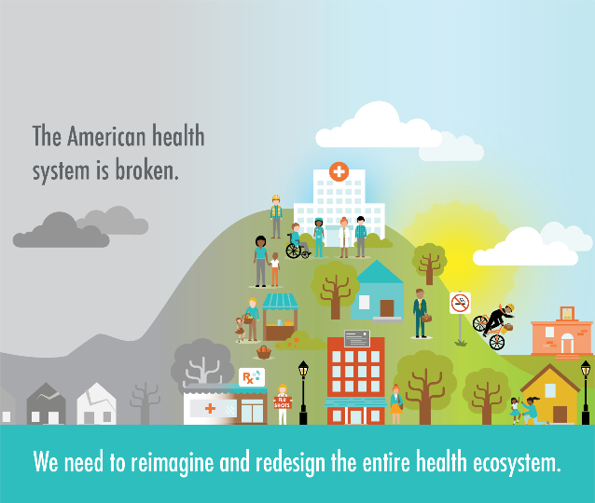
Our Purpose
ReThink Health catalyzes changemakers
to reimagine and transform health

Slide 4
ReThink Health’s Work in the Field
We have supported numerous backbone organizations and funders
Worked in rural and urban settings: NY, AR, AL, SC, MD, WV, MA and with CMS’s Quality Improvement National Coordinating Center
Health care quality improvement
Chronic disease management
Population health improvement
Our focus leans heavily on the practices of community organizing to advance the aims of the initiative

Slide 5


Follow along with us on Twitter!
@ReThinkHealth
#RTHmodel
#ReThinkStewardship
Notes:
Follow along with us on Twitter! Our handle is @ReThinkHealth (at ReThink Health). When talking about the Model we use hashtag RTH Model and when talking about Stewardship we use hashtag ReThink Stewardship

Slide 6
Welcome, Goals and Introduction
To discuss three major challenges of resident engagement and leadership development
To offer a set of tools to enable you to get started
To share real examples and stories from Niagara Falls

Slide 7
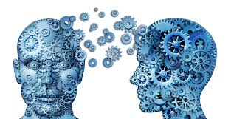
Table Discussion: 7 min
Think silently about the question and write it on the post it note
Briefly share your name, organization and interest in this topic.
What key lesson (one) did you learn about resident engagement that you must share with participants at your table?
Please make sure that everyone gets a chance to share their thoughts on the question.

Slide 8
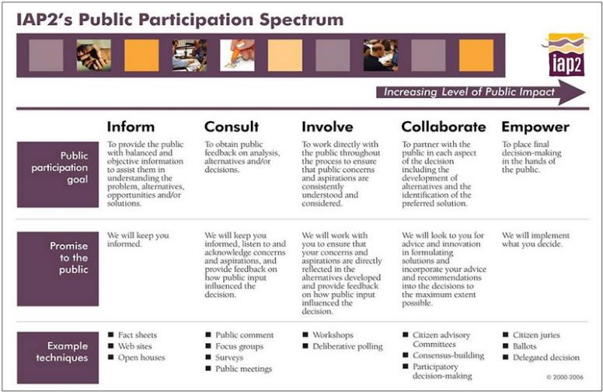
Public participation Spectrum

Slide 9
Niagara Falls Resident Leadership Development Program

Slide 10
What is our Theory of Change?
PEOPLE
Recruiting and developing leadership
POWER
Building a community around that leadership to create power
CHANGE
Using this power to address the challenge the constituency is called to face
… people acting together
to change the status quo
Notes:
So, what are we building this snowflake to actually do? What is the kind of change we are bring about? The theory of change—the way we seek to accomplish the transformation we seek unfolds by activating people to act in the service of their interests and values, building community and collective power from our combined resources and using this power to address this collective challenge. We build the snowflake to build collective power.

Slide 11
What is Leadership?
‘Leadership is accepting responsibility for enabling others to achieve shared purpose in the face of uncertainty.’-Marshall Ganz
A practice, not a position
Authority is earned, not bestowed
Focus is on developing others, not just yourself
Notes:
TALKING POINTS:
There are many definitions of leadership. We offer this definition because it underpins the tools we are working with for the rest of the day.
It is a practice, not a position of bestowed authority, like a manager or a CEO.
This is the leadership that emerges when someone sees something that urgently needs to be changes and that represents an affront to their values. The leader is the one who accepts responsibility for changing the status quo.
The definition also points to a very critical distinction: the leaders first move is towards “lifting up” or “enabling” others of like mind and situation to join the leader in taking collective action to address the intolerable condition.

Slide 12
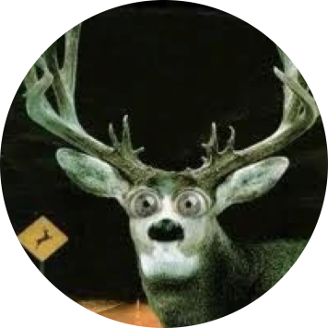
Leadership in the face of uncertainty……
Uncertainty poses strategic and motivational challenges…
Notes:
TALKING POINTS:
Why uncertainty? Because in certain times, you don’t really need good leaders, you simply need good managers. It is in uncertain times, when there is a lot of fear and confusion about what to do next, that you need strong leadership—leadership that enables others to walk alongside you towards a common purpose.
It is times like these that require a leader to address motivational and strategic challenges by helping articulate a common purpose and a strong rationale for why action in the face of uncertainty matters.
ASK PARTICIPANTS:
Can you think of a time when you have been this kind of leader? How did you frame the challenge and the reasons why they needed to be overcome?
(if time permits—as them to pair share for 5 min and reflect back to the plenary group)

Slide 13



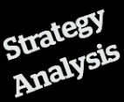


HOW
WHY
ACTION!

Slide 14
Challenge 1: People don’t care
“People don’t care
that you know
until they know
that you care.”
-Anonymous

Slide 15
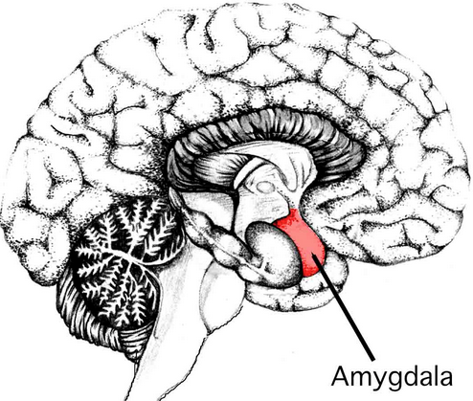
Decisions are emotional
The amygdala
controls
emotions.
People with
damaged
amygdala can
list options
endlessly but
can’t decide.
Decisions rest on
judgments of
value.
If we can’t feel
emotion, we can’t
experience the
values that
orient us to the
choices we make.

Slide 16


Our Values Inspire Our Actions
values
decisions
emotions
Knowing emotional information is as important as knowing logical information.
action

Slide 17
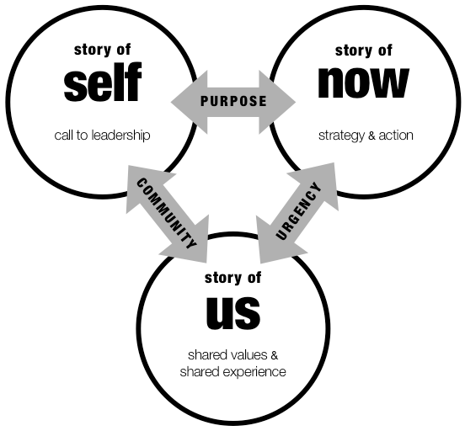
The Public Narrative Framework:
Story of Self, Us and Now
Why me?
Why now?
Why us? What is our common source of hope?

Slide 18
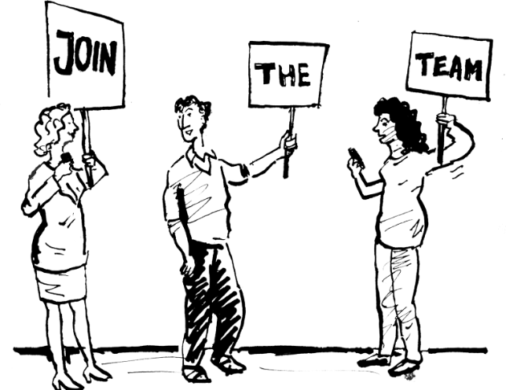
Challenge 2: People don’t want to get involved

Slide 19
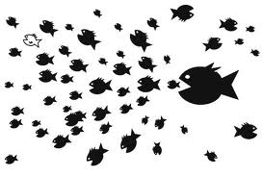
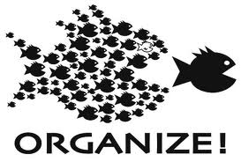
What is Power?
The ability to achieve purpose
Notes:
What do we mean by “building power”? we look at power in terms of capacity—the ability to achieve collective purpose through acting together towards a common goal.

Slide 20
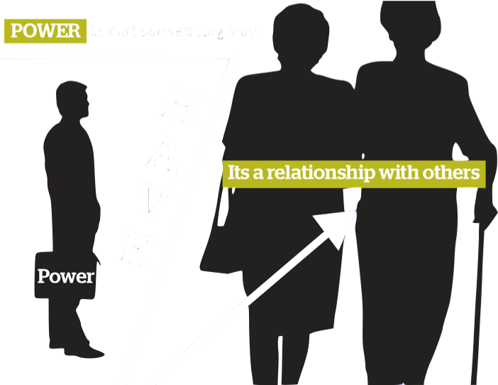
Notes:
In this framework, power is not something you have as a result of fame, fortune or bestowed authority. This kind of power is built in relationship with others.

Slide 21
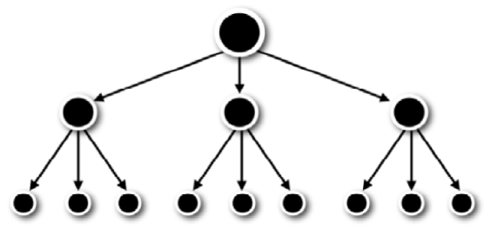
Common Leadership Models
“I’ll take care of it.”
“Who’s in charge here?”
“Hail Caesar!”
Notes:
TALKING POINTS:
This understanding of leadership is different from the typical models of leadership we are familiar with.
Ask someone to explain what these models of leadership is like. Ask for examples, like church, corporate life, hospitals, etc…
How does it feel to be the dot in the center?
How does it feel when all the dots run in different directions? What challenges come up?
How does it feel to be one of those tiny dots at the bottom? Are they empowered?
Let your participants describe each model for you. Emphasize the fact that none of these models are empowering over a long period of time. Nor do these models build and develop leadership in others.

Slide 22
Interdependent Leadership:
Grounded in Shared Commitments and Values
COMMITMENT
COMMITMENT
COMMITMENT
COMMITMENT
Notes:
So, becasue the transfomation change we seek Is too great for anyone of us to accomplish alone, we need to learn a set of skills that intentionally enables us to build interdependent leadership—in teams that hold together based on shared interest and values.

Slide 23
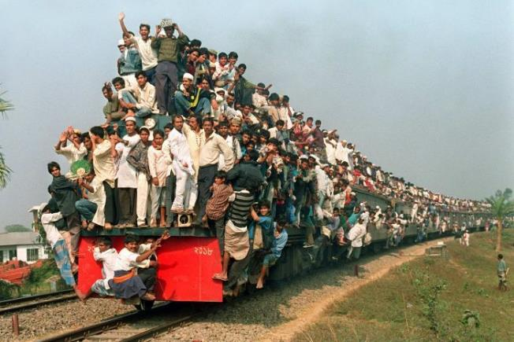
Challenge 3: We don’t have enough resources

Slide 24
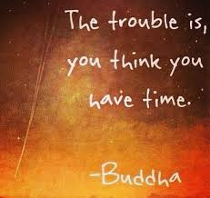
Campaigns, Defined:
Concentrated, intense effort
Clear beginning and end
When finished, it’s clear whether or not you achieved your specific measurable aim
Create a useful, intentional urgency

Slide 25
Why Campaign?
Provides a strategic and motivational way to organize our activities
Each tactic lays the groundwork for the next one
Provides an opportunity for learning by allowing for “small losses” in the early days of a campaign
Treats time differently: intended to disrupt cyclical organizational patterns

Slide 26
Your Timeline: Sequencing Your Tactics
Capacity
(people, skills, etc.)
Mountaintop outcome
Evaluation
& next steps
Peak outcome
Team Celebration!
Peak outcome
Team meetings
Kick-off outcome
Team meetings
Team meetings
Foundation
Time

Slide 27
Panel Discussion

Slide 28


